Slide 1

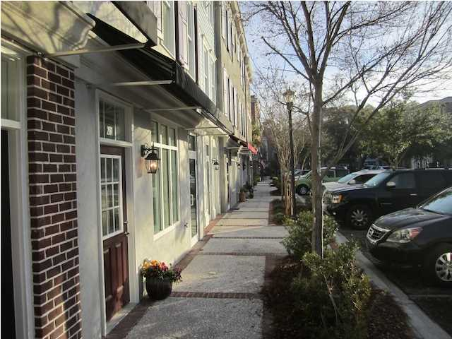
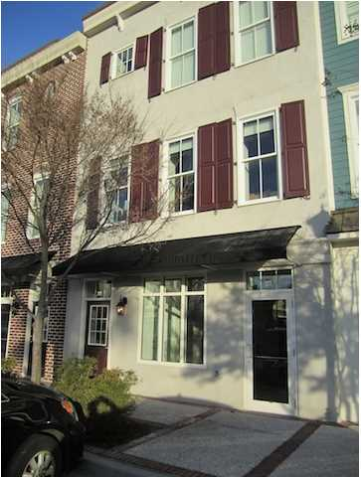
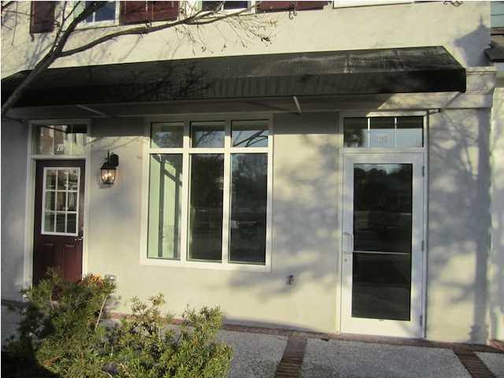
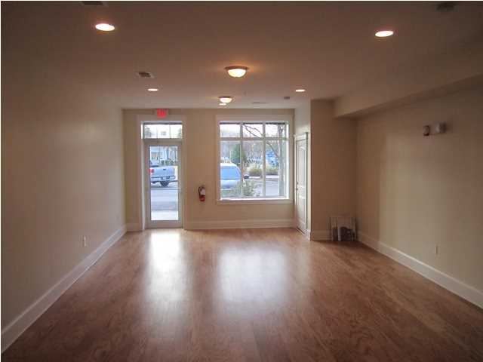
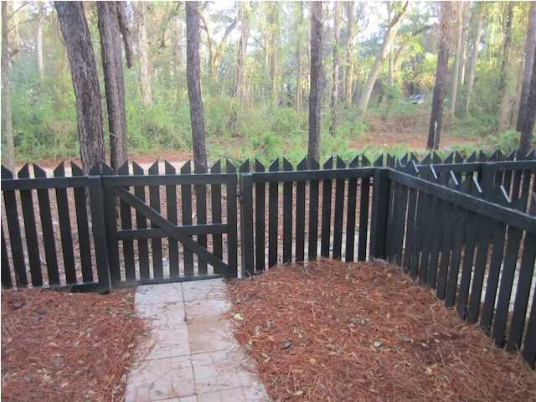
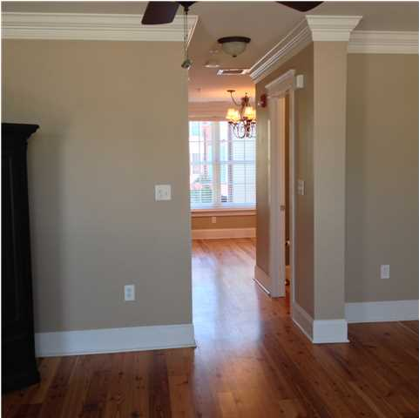
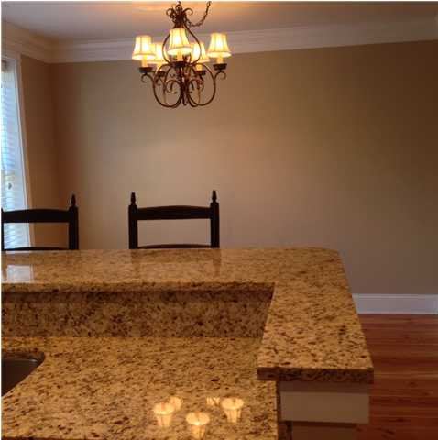

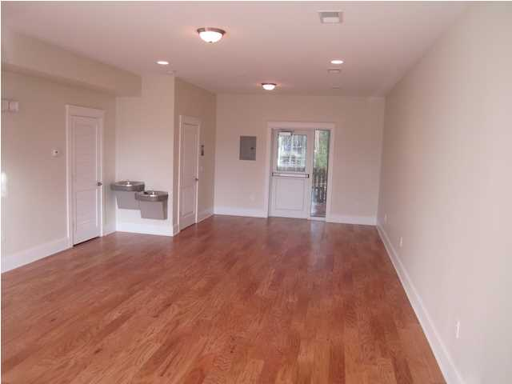
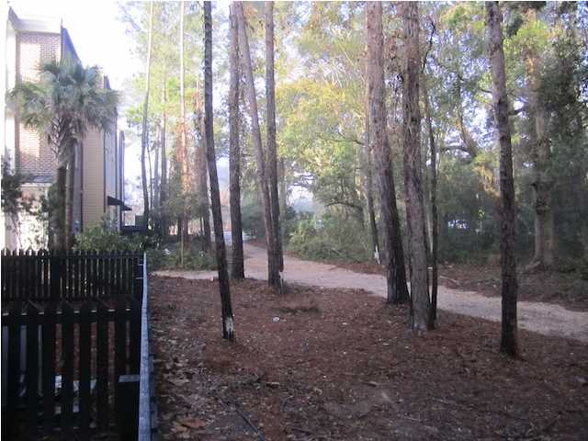
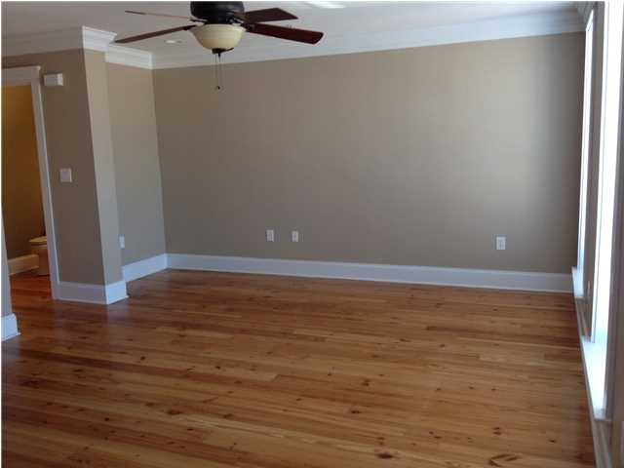

Business For Sale Charleston Area Coffee Shop and Café
CONFIDENTIAL
Amazing Business For Sale in a Fantastic Location
You will not believe how neat and well run this business is with a loyal customer base and raving fans.
A great opportunity to consider.
Serious inquiries only please.
More information will be provided by providing a Non-Disclosure Agreement to protect confidentiality, which can be found at the link below:
http://seaydevelopment.com/charleston-coffee-shop-and-cafe-for-sale/
Shhhh!
Address: Confidential
Area: Confidential
Building Square Feet: Confidential
Category: Confidential
City: Charleston
County: Charleston
Listing ID: Confidential
Listing Price: Confidential
Max Contiguous SqFt: Confidential

