Slide 1

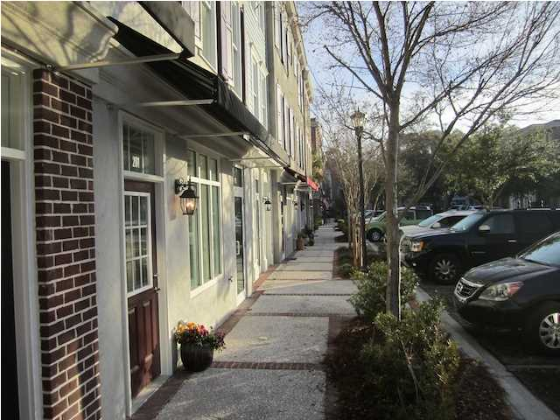
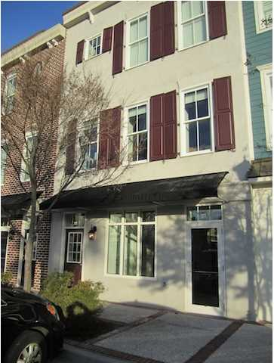
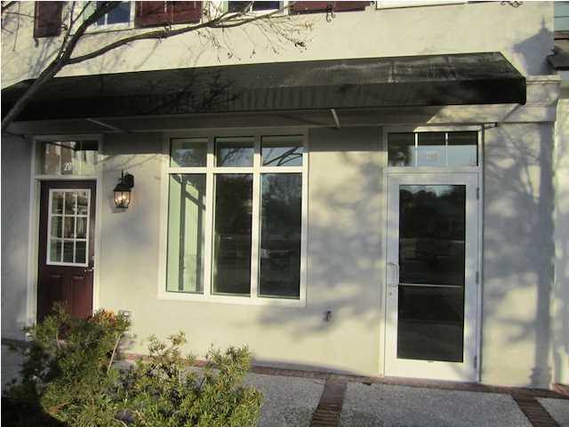
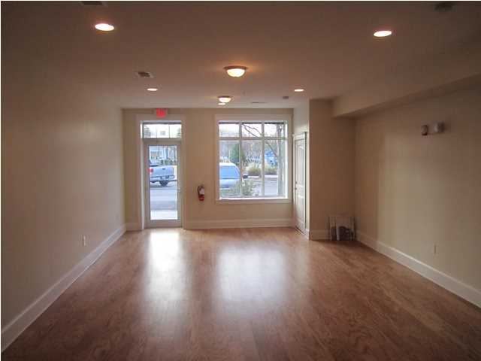
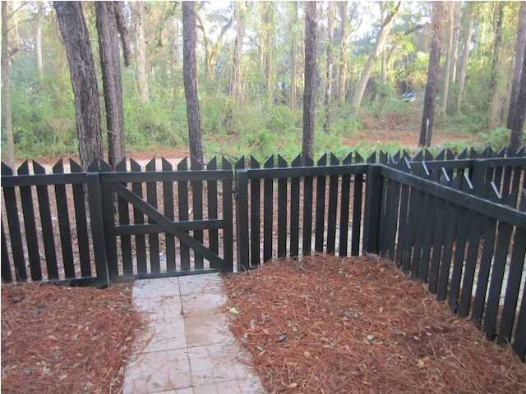
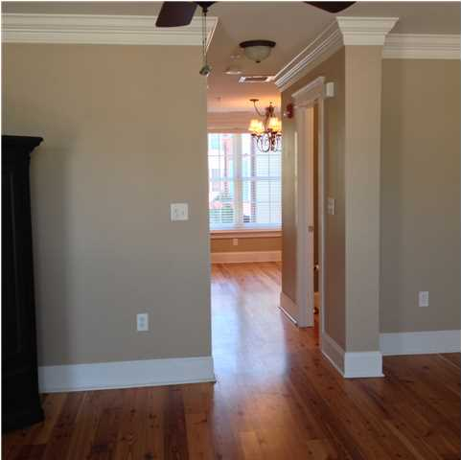
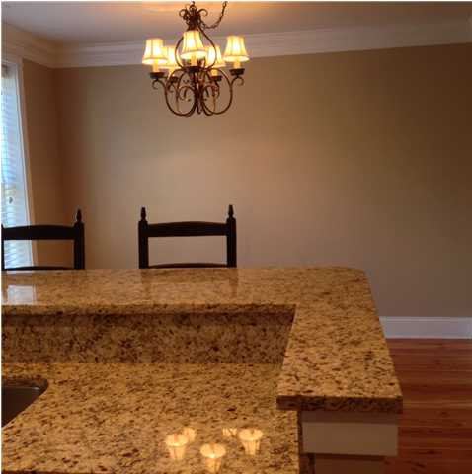

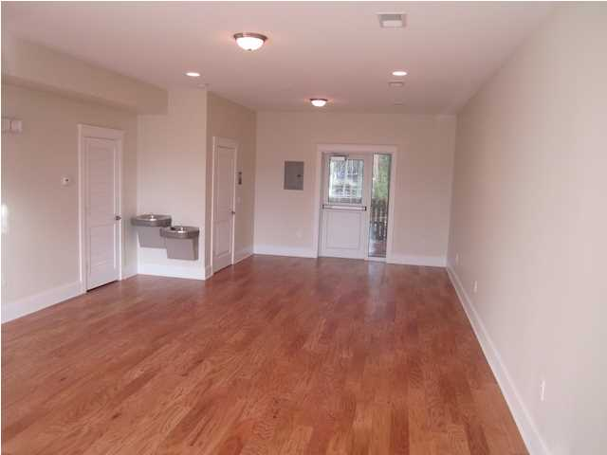
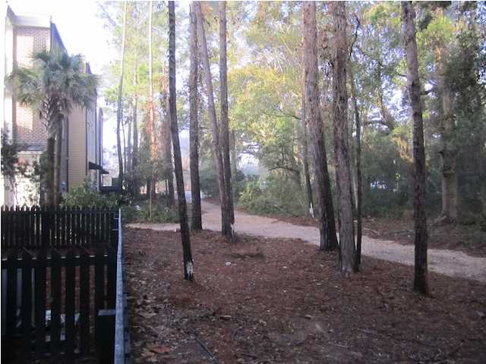
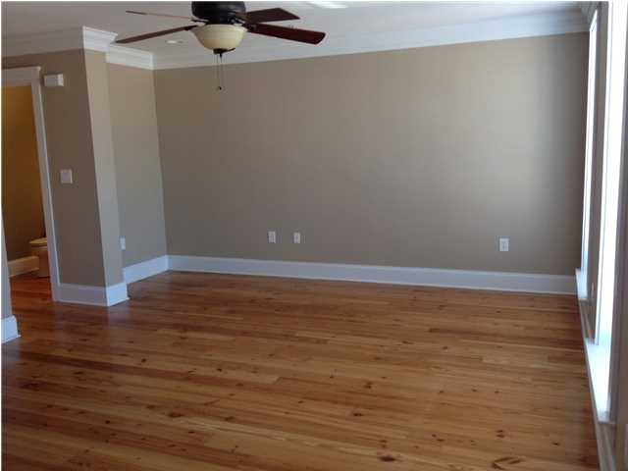

Dermatology Practice for Sale in Charleston, South Carolina
CONFIDENTIAL
Confidential Dermatology Practice for Sale in Charleston, South Carolina which can include the current real estate.
Practice has been established for years and the current doctor can remain and work further or they are willing to retire as well.
Practice is located close to major highways and other doctors.
A Confidential Non-Disclosure is required to obtain further information on the location and practice. Serious inquiries only please.
Shhhh!
Address: Confidential
Area: Confidential
Building Square Feet: Confidential
Category: Confidential
City: Charleston
County: Charleston
Listing ID: Confidential
Listing Price: Confidential
Max Contiguous SqFt: Confidential

