Slide 1

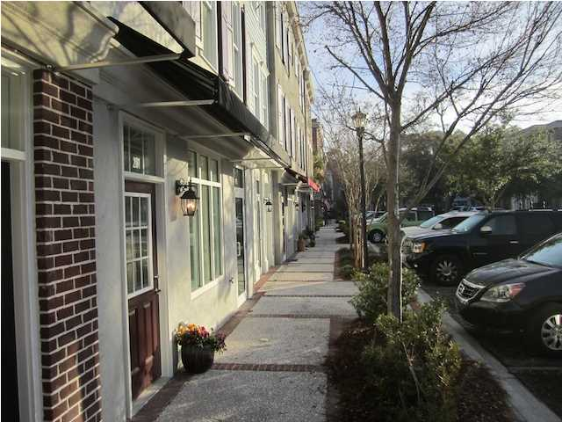
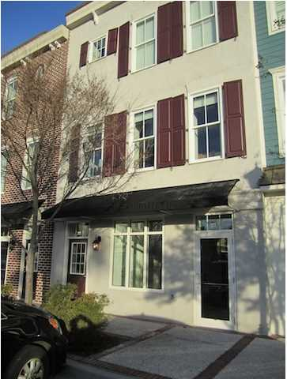
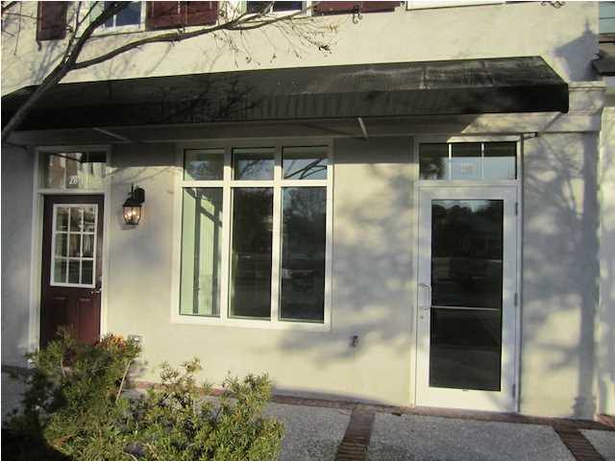
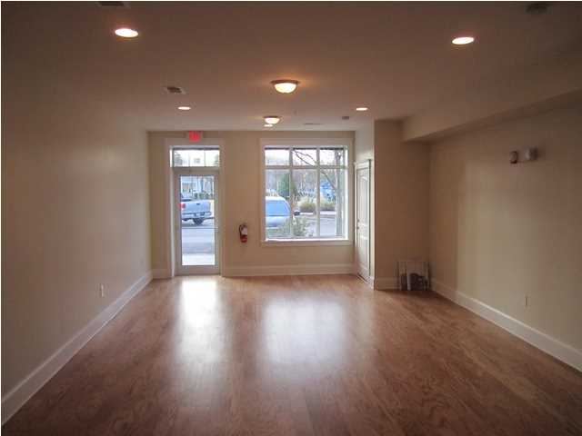
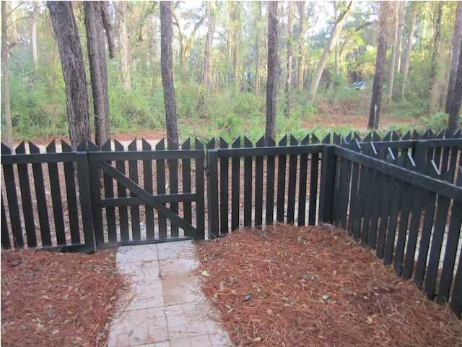
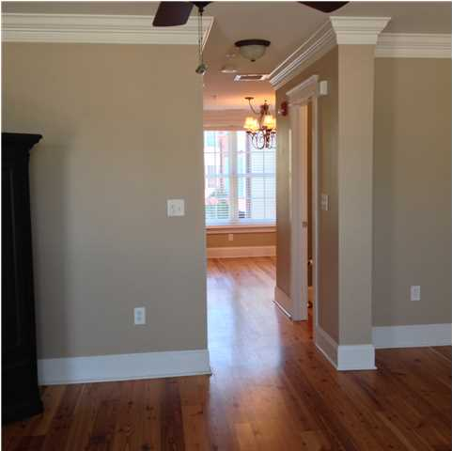
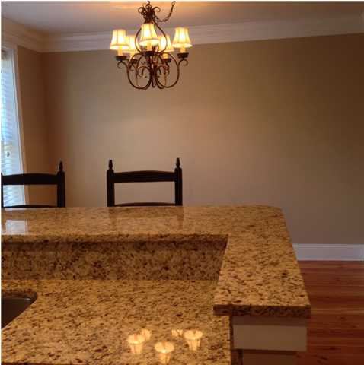

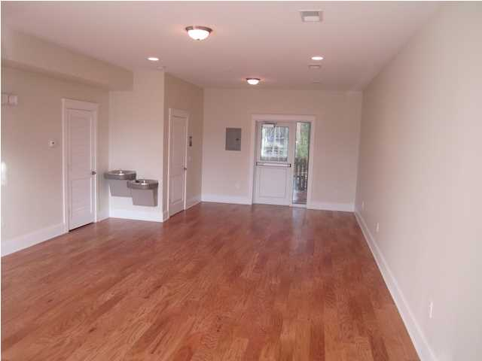
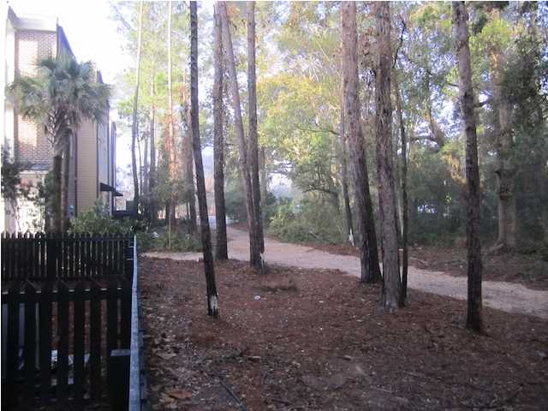
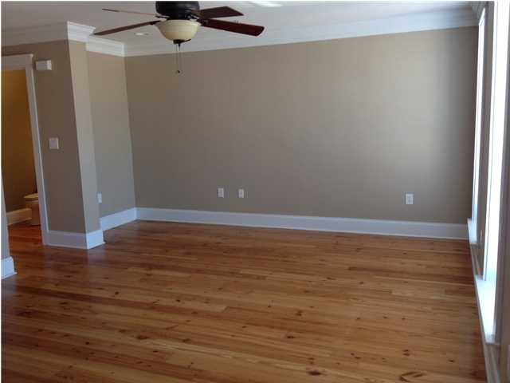

Luxury Student Housing for Sale in Charleston, South Carolina
CONFIDENTIAL
Luxury Student Housing (Confidential) for Sale in Charleston, South Carolina:
Confidential listing for a fully occupied and operating luxury student housing project in Charleston, South Carolina. If you don’t know Charleston, there is a lack of student housing due to Charleston School of Law, College of Charleston and the Medical University of South Carolina. I will need you to request the Confidentiality Agreement to learn more.
A Confidential Non-Disclosure is required to obtain further information on the location. Serious inquiries only please. My client and I expects confidentiality and professional conduct.
Shhhh!
Address: Confidential
Area: Confidential
Building Square Feet: Confidential
Category: Confidential
City: Charleston
County: Charleston
Listing ID: Confidential
Listing Price: Confidential
Max Contiguous SqFt: Confidential

