Slide 1

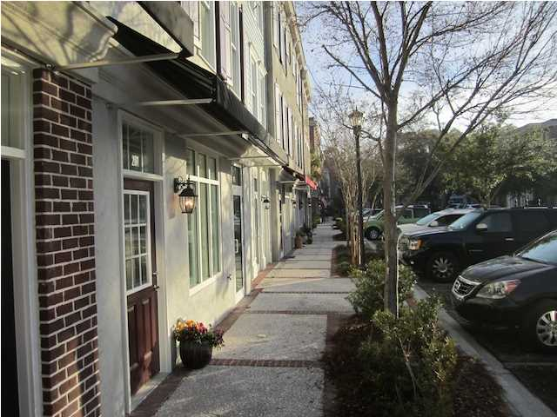
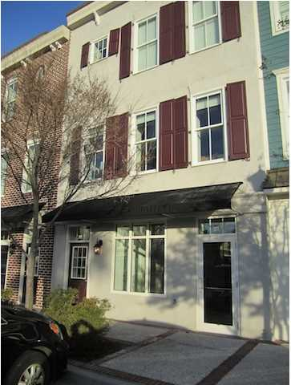
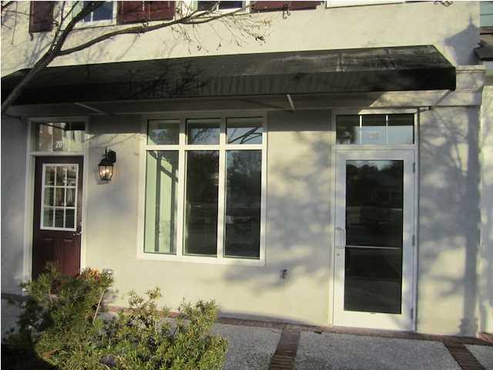
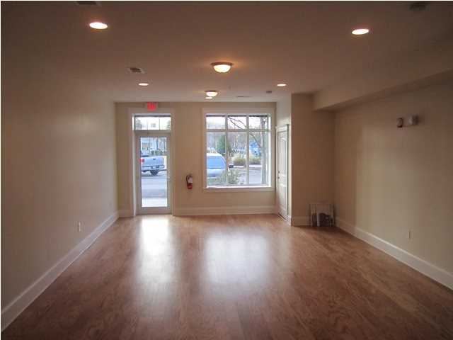
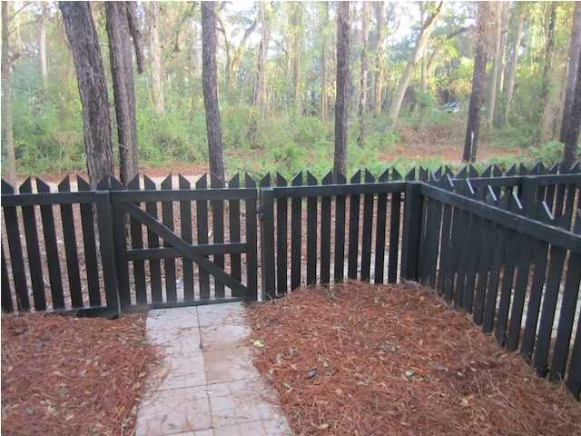
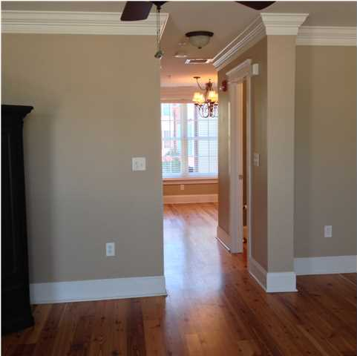
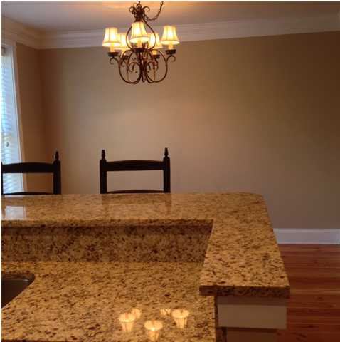
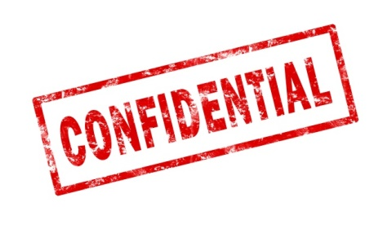
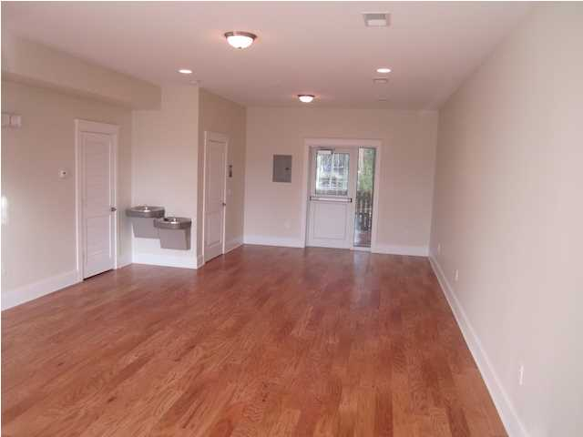
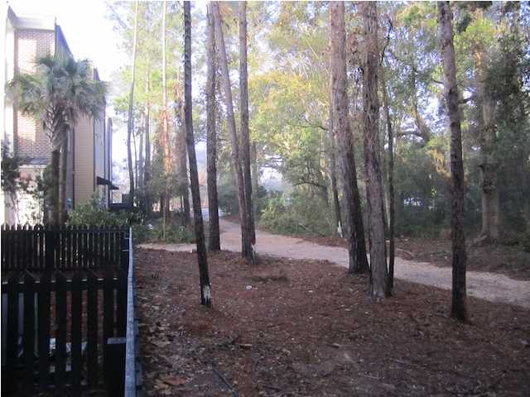
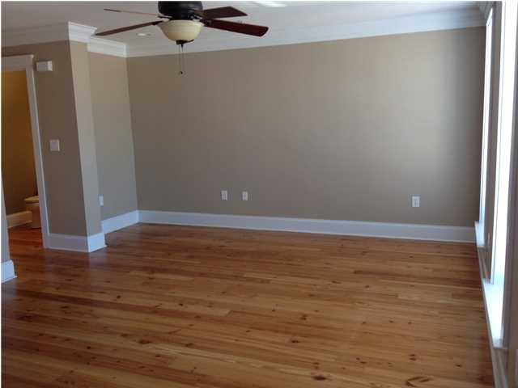

Hotel For Sale in Mount Pleasant, SC
CONFIDENTIAL
Hotel for Sale in Mount Pleasant, South Carolina.
Minutes from Downtown Charleston, which was recently named the #1 International Travel Destination by Conde Nast Traveler October 2012. The Congressional Medal of Honor Museum Society and Patriots Point have announced plans to build a $100 million museum along the Cooper River just a few miles away which should offer nice growth due to the projected visitors and similar customer demographic. All spacious suites at this extended stay hotel come complete with separate areas for relaxing, sleeping and eating. Each suite has a fully equipped kitchen stocked with a microwave, refrigerator, freezer, two-burner cooktop, coffee maker, cookware, utensils and dishwasher. Additional in-room amenities include hair dryers, flat-screen televisions, irons, ironing boards and cable television. Some rooms are equipped with sofa sleepers and whirlpool bathtubs. Handicap accessible and non-smoking rooms can be requested. NOTE: Alternate/Adaptive Reuse Opportunities Exist. Call for details.
$7,275,000
71 Rooms
Renovated with 3 Years Left on Brand
ADR $105.85
More information will be provided by providing a Non-Disclosure Agreement to protect confidentiality, which can be found at the link below:
http://seaydevelopment.com/hotel-for-sale-in-mount-pleasant-south-carolina
Shhhh!
Address: Confidential
Area: Confidential
Building Square Feet: Confidential
Category: Confidential
City: Mount Pleasant
County: Charleston
Listing ID: Confidential
Listing Price: Confidential
Max Contiguous SqFt: Confidential

