Slide 1
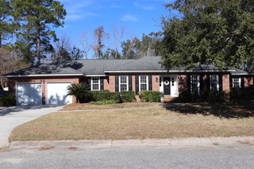
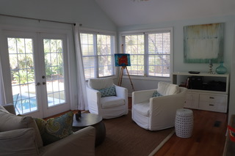
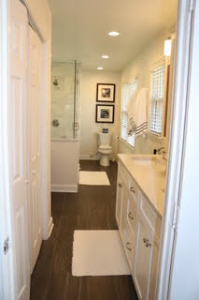
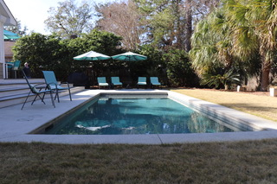


Coming Soon!!
Heart of Mt. Pleasant by Shem Creek
2500 Draymohr Court
Park West
Mount Pleasant, SC 29466
MLS# 19025454 ~ $379,000
Here is your chance to make your clients' holidays happier! Do you know someone searching for that perfect Mt. Pleasant home? One that is in a mature neighborhood bordering Shem Creek, updated with tasteful finishes throughout, with a gorgeous sunroom overlooking a stunning gunite pool in a perfectly private back yard? Do you have a client who would like to live in walking distance to Shem Creek (Park and Restaurants) as well as Trader Joe's? Which of your clients would enjoy living in a community with its own boat launch for residents only and no HOA fees? Call me for the details on this beautiful home in sought after Cooper Estates in Mt. Pleasant. The home has 3 bedrooms PLUS a designated office space. Updated throughout, the decor and finishes are absolutely stunning, AND the home has a new HVAC system as well. This is truly a move-in ready home for someone looking to enjoy the CAREFREE LIFESTYLE in the heart of Mt. Pleasant, minutes to downtown Charleston and the beaches of Sullivans Island. This is a STAYCATION home- gunite pool in large private yard with gorgeous landscaping and a designated space to park your boat beside the house. DON'T WAIT until this home hits the market- CALL ME TODAY for additional details and to arrange a tour before we go on the MLS. Happy Holidays!
* Professional photos coming soon.
Ellen O'Neil
Broker/Owner, ABR, e-PRO, CNE
Charleston Realtor of Distinction
(843) 300-8530
www.EllenONeilProperties.com

