Slide 1
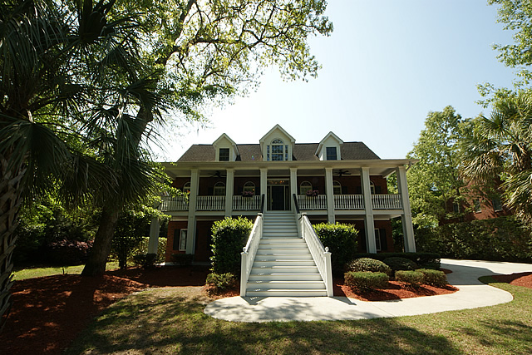
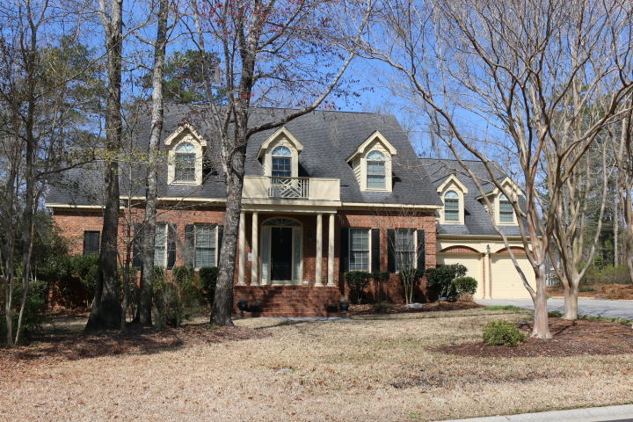
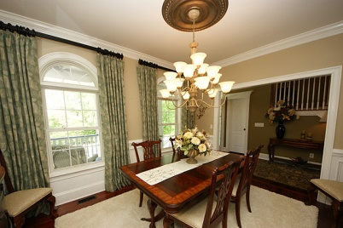
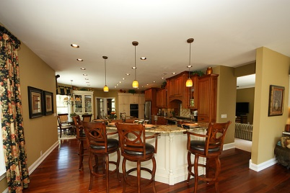
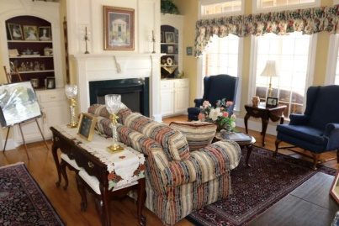
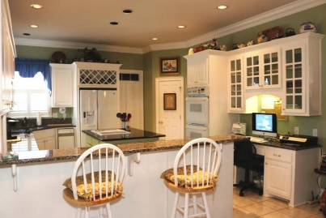
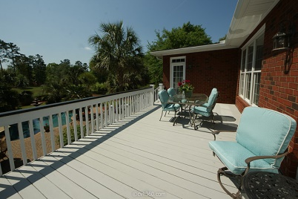
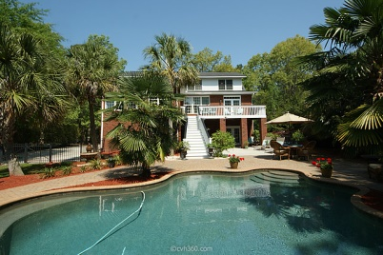
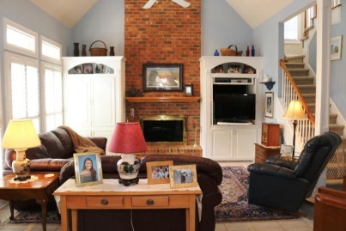
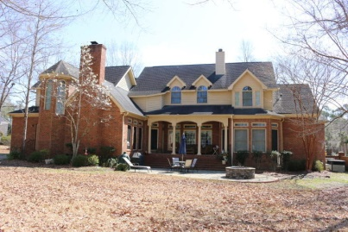
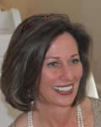

Coosaw Creek Open Houses Thursday, June 11th 1:00-2:30
$5,000 Agent Bonus!
4209 Buck Creek Court
MLS# 15009349
$689,000
4,250 Sq. Ft | 5 BR | 4 ½ BA
4219 Sawgrass Drive
MLS# 15006100
$667,500
4,530 Sq. Ft | 4 BR | 3 BA | 2 Half Baths
Come see two lovely homes in Coosaw Creek Country Club!
~~ $150 Gift card drawing if you register at both homes ~~
Susan Weeks
(843) 813-0495
susanweeksdesign@gmail.com
Sammye Blackard
(843) 224-8422 sblackard@carolinaone.com
AgentOwned Charleston Group
902 Savannah Hwy
Charleston, SC 29407-7802
Carolina One Real Estate
900 N Main St.
Summerville, SC 29483

