Slide 1


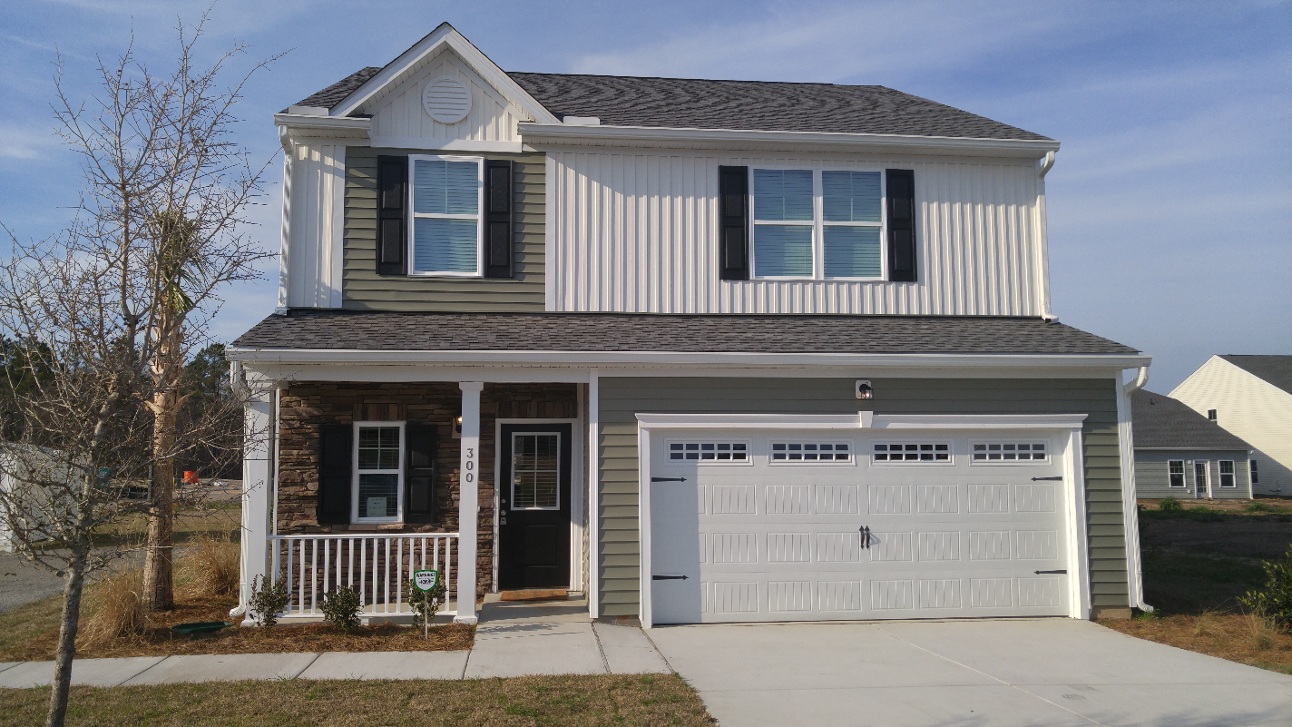
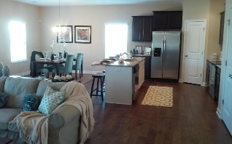
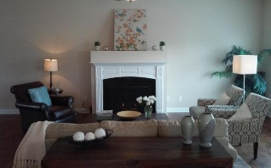
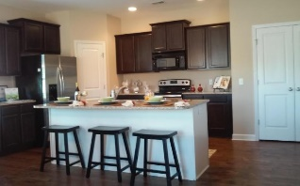
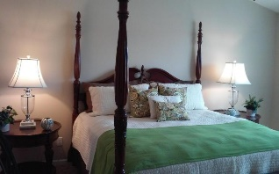
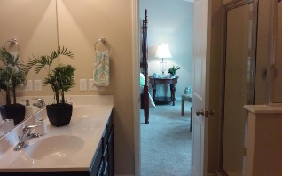
OPEN HOUSE Saturday, March 12th from 12-4 300 Silver Leaf Drive Cypress Grove Subdivision Moncks Corner
Food and refreshments will be served. Crescom Bank will be drawing for home improvement gift cards.
Buyer incentives will include stainless steel appliances and two inch blinds throughout on inventory homes.
Agent Incentive: $1,000 AmEx gift card on standing inventory, must close on or before April 30th for incentives to apply.
For more information, contact John Vance
john@mysouthwindhome.com | (843) 708-0584 | www.mysouthwindhome.com
Southwind Realty | 501 Bransom Court Ste 400 | Mt. Pleasant, SC 29464

