Slide 1



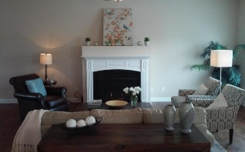
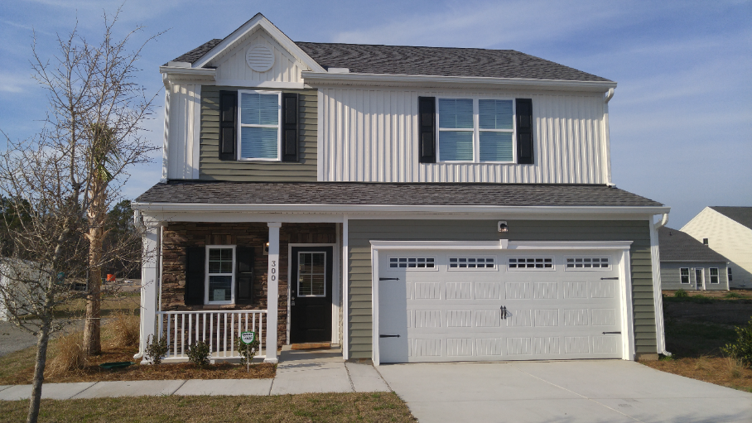
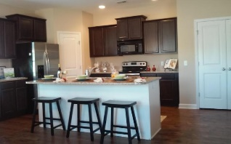
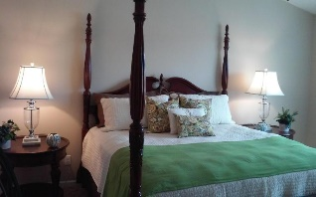
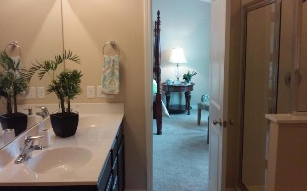
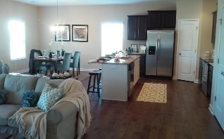




Celebrate Cinco de Mayo at Cypress Grove!
May 5, 2016 from 4:00 - 7:00pm
300 Silver Leaf Drive
Moncks Corner, SC 29461
Come enjoy:
Catered dinner by Moe's Southwestern Grill
Music Provided
Great games with chance to win $500.00 Visa Card.
$100.00 gift cards and other great gift giveaways!
Must be present to win!
Food provided by
Prizes provided by
RSVP to
www.mysouthwindhome.com | Southwind Realty | 501 Bransom Court Ste 400 | Mt. Pleasant, SC 29464
Vicki Kramer
843-270-4828
vicki@mysouthwindhome.com
John Vance
843-819-0039
john@mysouthwindhome.com

