Slide 1
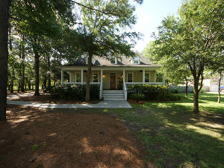
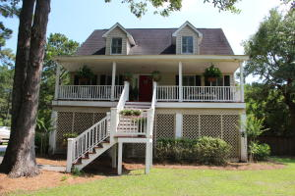
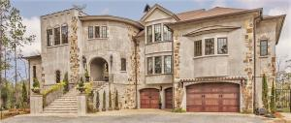
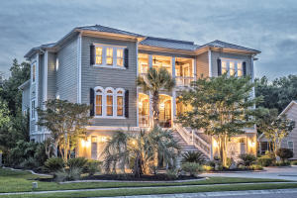
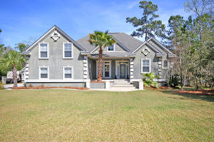
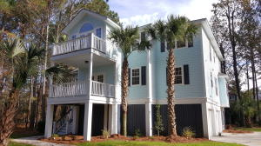
Darrell Creek Agent Open House Tour
Friday July 8th from 1-4pm
$150 Gift Card Raffle!
433 Commonwealth Road
MLS# 16015851
$550,000
Listed by
Cathy Sembower
Carolina One Real Estate
843-259-1350
csembower@carolinaone.com
445 Commonwealth Road
MLS# 16014155
$569,000
Listed by
Lauren Courcoux
Carolina One Real Estate
843-224-8613
lauren.courcoux@carolinaone.com
3618 Coastal Crab
MLS# 16007661
$1,399,999
Listed by
Todd McKenna
Keller Williams Realty
843-870-8110
todd@toddmckennarealestate.com
3759 Saint Ellens Drive
MLS# 16011129
$1,249,000
Listed by
Todd McKenna
Keller Williams Realty
843-870-8110
todd@toddmckennarealestate.com
3774 Saint Ellens Dr
MLS# 16007968
$665,000
Listed by
Jeff Cook
Jeff Cook Real Estate
843-225-2002
askjeff@jeffcookrealestate.com
3738 Station Point Ct.
MLS# 15031102
$599,990
Listed by
Jay Satterfield
Golden Bear Realty
843-224-6380
jays@goldenbearrealty.com
Agents must attend all 6 properties to qualify to win a $150 gift card.

