Slide 1





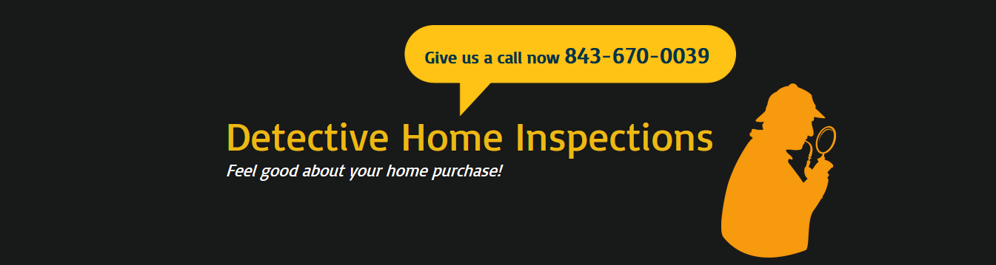
Detective Home Inspections, LLC
843-670-0039
dhinspect@yahoo.com
www.dhinspect.com
facebook.com/DetectiveHome.RandyWebb
A Gift for Your Clients
Introductory Offer
Add Detective Home Inspections to your list of inspectors. When one of your customers use Detective Home Inspections, present them with this coupon to receive $50.00 off the regular price.*
*This $50.00 off coupon must be mentioned when booking an inspection. Coupon must be presented at the beginning of the inspection. One (1) coupon per customer. Coupon good for: Greater Charleston area, including Goose Creek and Moncks Corner areas. Coupon and offer good until March 31, 2015.

