Slide 1
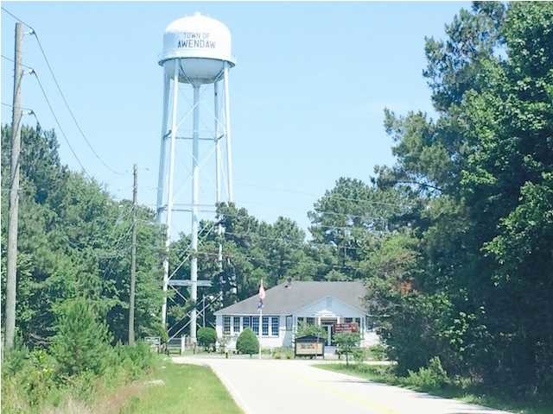
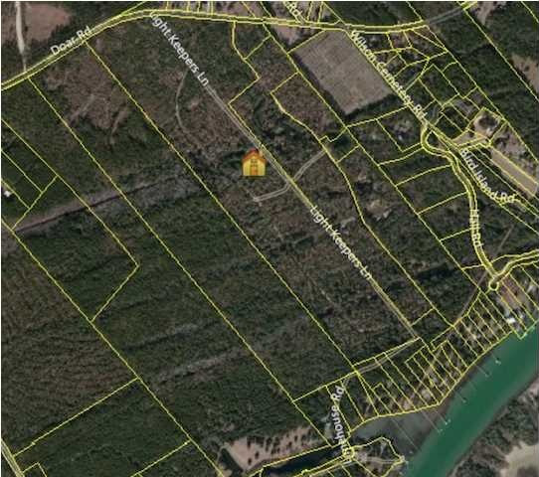
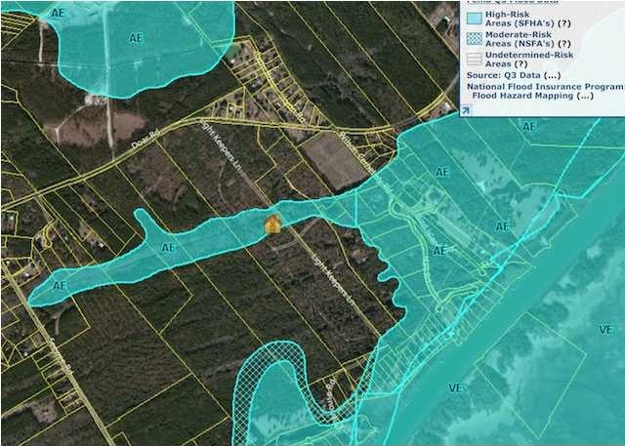


BUCHANAN TRACT LLC
DOAR RD
Awendaw, SC 29429
VACANT LAND FOR SALE
A developer's dream resurrected with this 113.18 Acre Tract with water access ready. Just off Doar Road, this large tract had plans for a Master Development years ago before the economy turned against it. Now, priced ready for development, the Buchanan Tract is poised for the expansive growth of Mt. Pleasant and perfect for those homeowners that want a nice homesite yet not too terribly far off the beaten path. Just down for Town Hall, you can develop this project for a home grown tomatoes feel with a density potential to make your numbers work. Other residential developments are taking shape close by. This offering consists of two tax map numbers, one of which, is a water front lot allowing a potential waterfront amenity center for a residential development. TMS number are 680-00-00-085 and 681-00-00-083.
Catylist ID: | #29854130
Gross Land Area: | 113.20 Acres
Sale Price: | $2,950,000
Unit Price: | $26,060 Per Acre
Zoning: | R-4 - Single Family Residential 4 District
Property Subtypes: | Agricultural, Multi-Family, Residential (Single Family)
Sale Terms: | Cash to Seller, Other
County: | Charleston
Tax ID/APN: | 680-00-00-085
David H Seay
CCIM, BIC, CCIM, REALTOR
(843) 364-6720
david@seaydevelopment.com
Seay Development, LLC
3404-202A Salterbeck Street
Mt. Pleasant, SC 29466 www.seaydevelopment.com

