Slide 1
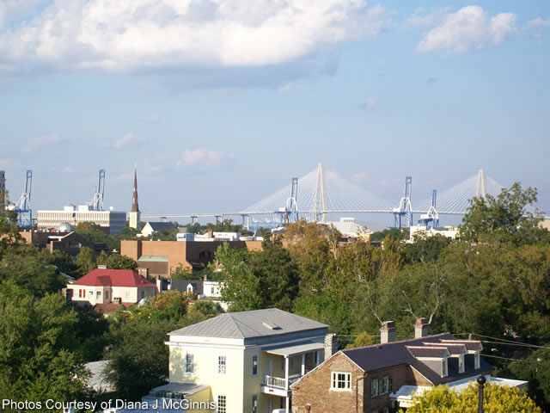

I have a CASH buyer looking for a .3+ acre lot downtown Charleston that is not currently on the market. Please call me if you have a Pocket Listing!
Cash Buyer Looking Downtown
Robin Phillips
(843) 214-8451
Robin@ThePhillipsRealtyGroup.com

