Slide 1
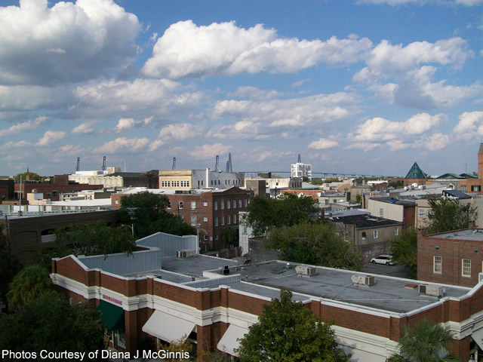
I have a buyer looking for a 3-4 unit multi-family property on the peninsula, up to $600k.
Do you have any pocket listings that match this criteria?
Please call/email to discuss…
Cash Buyer Looking Downtown
Mike Parrado
(843) 607-5946 Cell | mike@mattoneillteam.com
Matt O'Neill Real Estate | 940 Johnnie Dodds Blvd, Ste 100 | Mt. Pleasant, SC 29464

