Slide 1
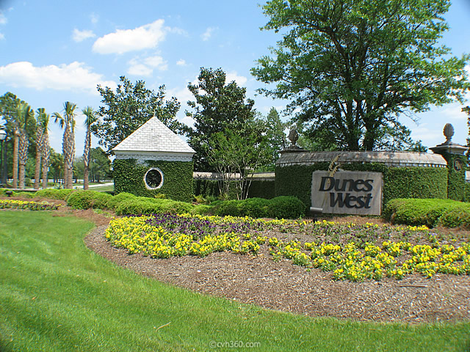
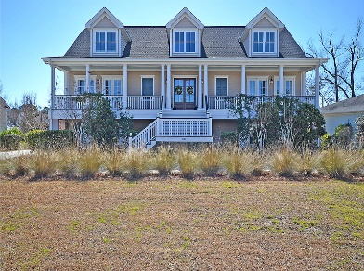
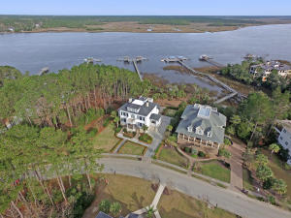
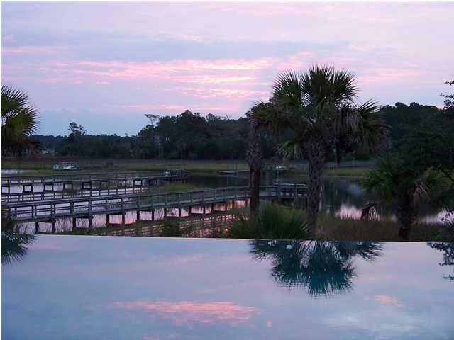
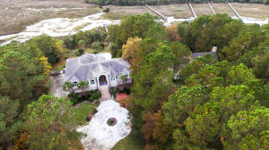
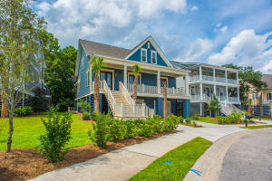
Dunes West Agent Open House Today
Thursday, February 25th from 11:00a-1:00p
Enter to Win a $100 Gas Card Giveaway for Visiting all 5 Homes!
You must visit each of the 5 homes to qualify for the drawings.
2740 Fountainhead Way
4 Bedrooms, 3 Baths, 3,838sf
MLS# 16004287 Offered at $775,000
Dave Friedman
Keller Williams Realty
843-466-5999
dave@davefriedmanrealestate.com
2848 River Vista Way
5 Bedrooms, 5/1 Baths, 6,299sf
MLS# 16000842 Offered at $1,925,000
Matt O’Neill Matt O'Neill Real Estate 843-532-4220
matt@mattoneillteam.com
2472 Darts Cove Way
5 Bedrooms, 3/1 Baths, 3,736sf
MLS# 16001445 Offered at $1,495,000
Matt O’Neill Matt O'Neill Real Estate 843-532-4220
matt@mattoneillteam.com
3016 Pignatelli Crescent
6 Bedrooms, 4/1 Baths, 5,283sf
MLS# 15030454 Offered at $1,100,000
Dave Friedman
Keller Williams Realty
843-466-5999
dave@davefriedmanrealestate.com
2982 River Vista Way
3 Bedrooms, 3 Baths, 3,111sf
MLS# 15021313 Offered at $1,239,339
Ashley Hanna
Pulte Homes
843-881-6060
ashley.hanna@jwhomes.com

