Slide 1
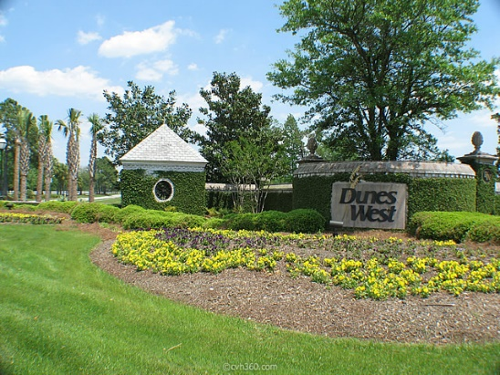
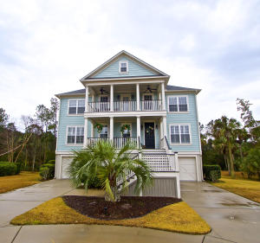
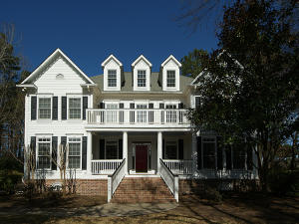
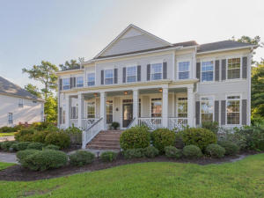
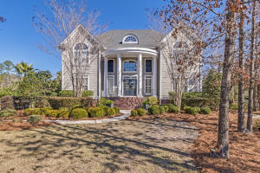
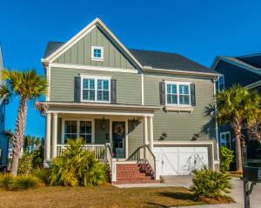
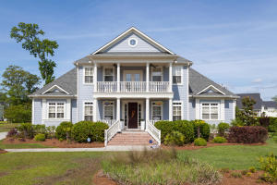
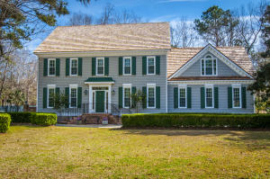
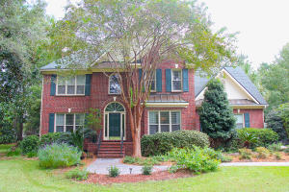
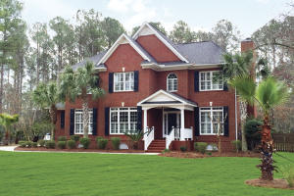
Dunes West Agent Open House
Thursday, March 2nd, 12:00-2:00
Please join us for lunch!
Remember to drop your business card at each home you visit
to increase your chances of winning $100 cash!
3044 Riverwood Drive
MLS# 17003094
$609,000
Trish Wheeler
843-532-4305
trish@trishwheelerrealestate.com
The Boulevard Company
2305 Darts Cove Way
MLS# 17004044
$739,000
Karla Leahy
843-452-6670
karlaleahy@gmail.com
Harbor City Real Estate Advisors
2818 Oak Manor Drive
MLS# 16022794
$760,000
Paula Watts
843-819-1582
paula@paulawatts.com
Keller Williams Realty Charleston
2484 Darts Cove Way
MLS# 17004525
$795,000
Crissy Rowell
843-377-5177
crissy.rowell@carolinaone.com
Carolina One Real Estate
1177 Ayers Plantation Way
MLS# 17004176
$630,000
Sybil Hill
843-834-6234
s.hill@carolinaoneplus.com
Carolina One Real Estate
3029 River Vista Way
MLS# 17002181
$735,000
Jim Oster
843-469-4333
james.oster@att.net
Century 21 Properties Plus
3447 Colonel Vanderhorst Circle
MLS# 17004178
$650,000
Dianne Broom
843-343-6207
dbroom@carolinaone.com
Carolina One Real Estate
3463 Colonel Vanderhorst Circle
MLS# 16026363
$649,900
Daniel Ravenel
843-343-5944
dravenel@danielravenelsir.com
Daniel Ravenel Sotheby's International Realty
1778 Shell Ring Circle
MLS# 17003894
$700,000
Sybil Hill
843-834-6234
s.hill@carolinaoneplus.com
Carolina One Real Estate
** Agents: please plan to show your pocket card at the gate **

