Slide 1
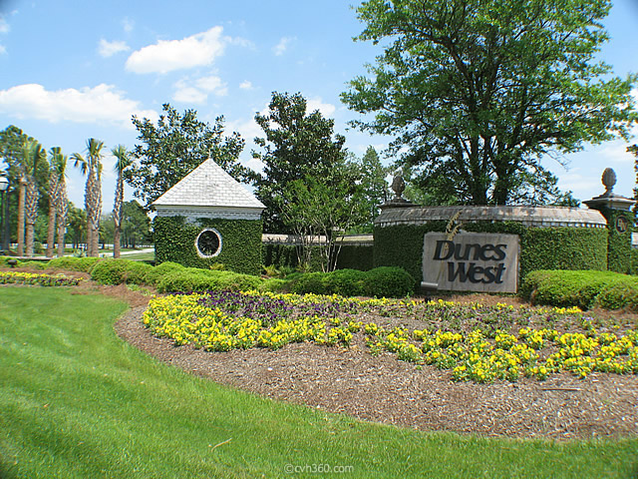
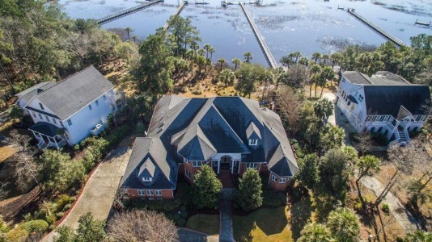
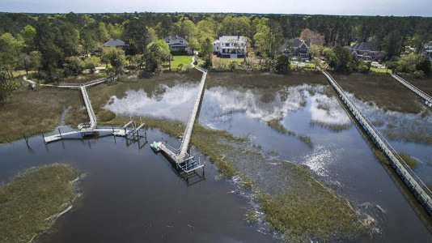

Dunes West Open Houses
Wednesday, April 6th from 11:30-1:30
Two beautiful waterfront homes on tour...visit both and be entered into a drawing for two different gas card givaways!
RSVP in advance and have your name entered twice!
Light food and drinks also provided at both homes.
1752 Greenspoint Court
5 Bedrooms, 3/1 Baths, 4,935sf
MLS# 16003260
Offered at $1,600,000
Melodie Smith
843-408-5067
melodie.smith@carolinaone.com
3092 Pignatelli Crescent
4 Bedrooms, 4/1 Baths, 4,295sf
MLS# 16008256
Offered at $1,500,000
Susan Cox
843-312-9264
susan.cox@carolinaone.com

