Slide 1
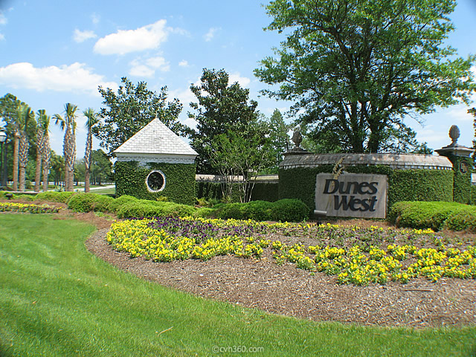
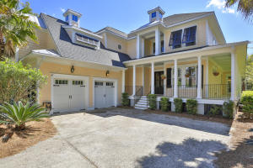
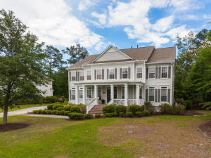
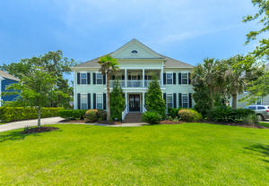
Dunes West Agent Open Houses
August 3rd from 12-2
$25 cash drawing. Must visit all 3 houses to qualify.
Food and drinks will be served!
2713 Fountainhead
5 Bedrooms, 4/1 Baths, 4,100sf
MLS# 16009168 Offered at $795,000
Christy Fenchuk Humphries
Dunes Properties of Chas
843-610-8228
chumphries@dunesproperties.com
2818 Oak Manor Drive
5 Bedrooms, 5 Baths, 4,300sf
MLS# 16011437 Offered at $825,000
Paula Watts
Keller Williams Realty 843-819-1582
paula@paulawatts.com
2768 Oak Manor Drive
6 Bedrooms, 5 Baths, 4,878sf
MLS# 16014910 Offered at $675,000
Carolyn Dubrofsky
The MarshallWalker.com Group
843-324-9645
cdubrofsky@comcast.net

