Slide 1
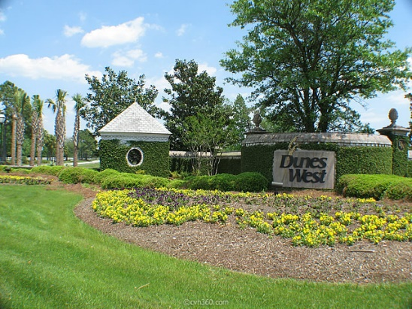
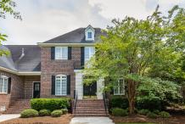
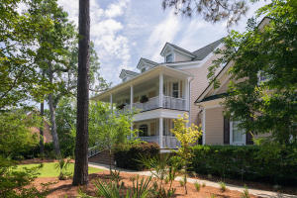
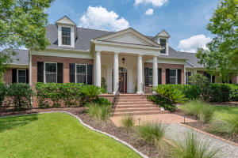
Darts Cove Way Agent Caravan
Wednesday, September 5th, 10:30a-12:30p
Refreshments will be served!
2332 Darts Cove Way
MLS# 18021780
$998,000
Andrea Rogers
843-532-3010
andrearogers1@gmail.com
AgentOwned Preferred Group
2364 Darts Cove Way
MLS# 18018604
$1,700,000
Charleston Fine Homes Team
843-270-1207
franne@charlestonfinehomes.com
Coldwell Banker Residential Brokerage
2368 Darts Cove Way
MLS# 18020748
$1,025,000
Georgia Bell
843-568-1601
georgiabell12@gmail.com
William Means Real Estate
** Agents: please plan to show your pocket card at the gate **

