Slide 1

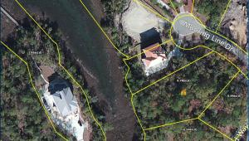
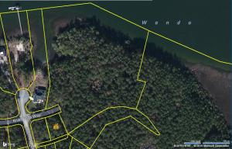



Build Your Dream Home!
FOR SALE – Vacant Land
Dunes West – The Harbour Subsection
4% Commission
1905 Mooring Line Drive 2879 River Vista Way
Listed @ $273,500
.78 acre marsh front lot
Views of the Wando River
Cul-de-sac w/Custom Homes
Lots of Building Options
Room For a Pool!
Short walk to crabbing dock
LOT A27
MLS # 15014866/4% Commission
Listed @ $214,700
.34 acre lot in Newest Section
Across From The Wando River
Side Entry OR Rear Entry Lot
Potential views of Wando River
Short walk to crabbing dock
Near Boat Launch
LOT 132
MLS # 15008826/4% Commission
Ask About Builder Options & House Plans!
Margaret Hekker Cell 843.296.7520
Broker / Owner mhekkerrealestate@gmail.com
Lighthouse Realty Group, LLC lighthouserealtygroupsc.com

