Slide 1

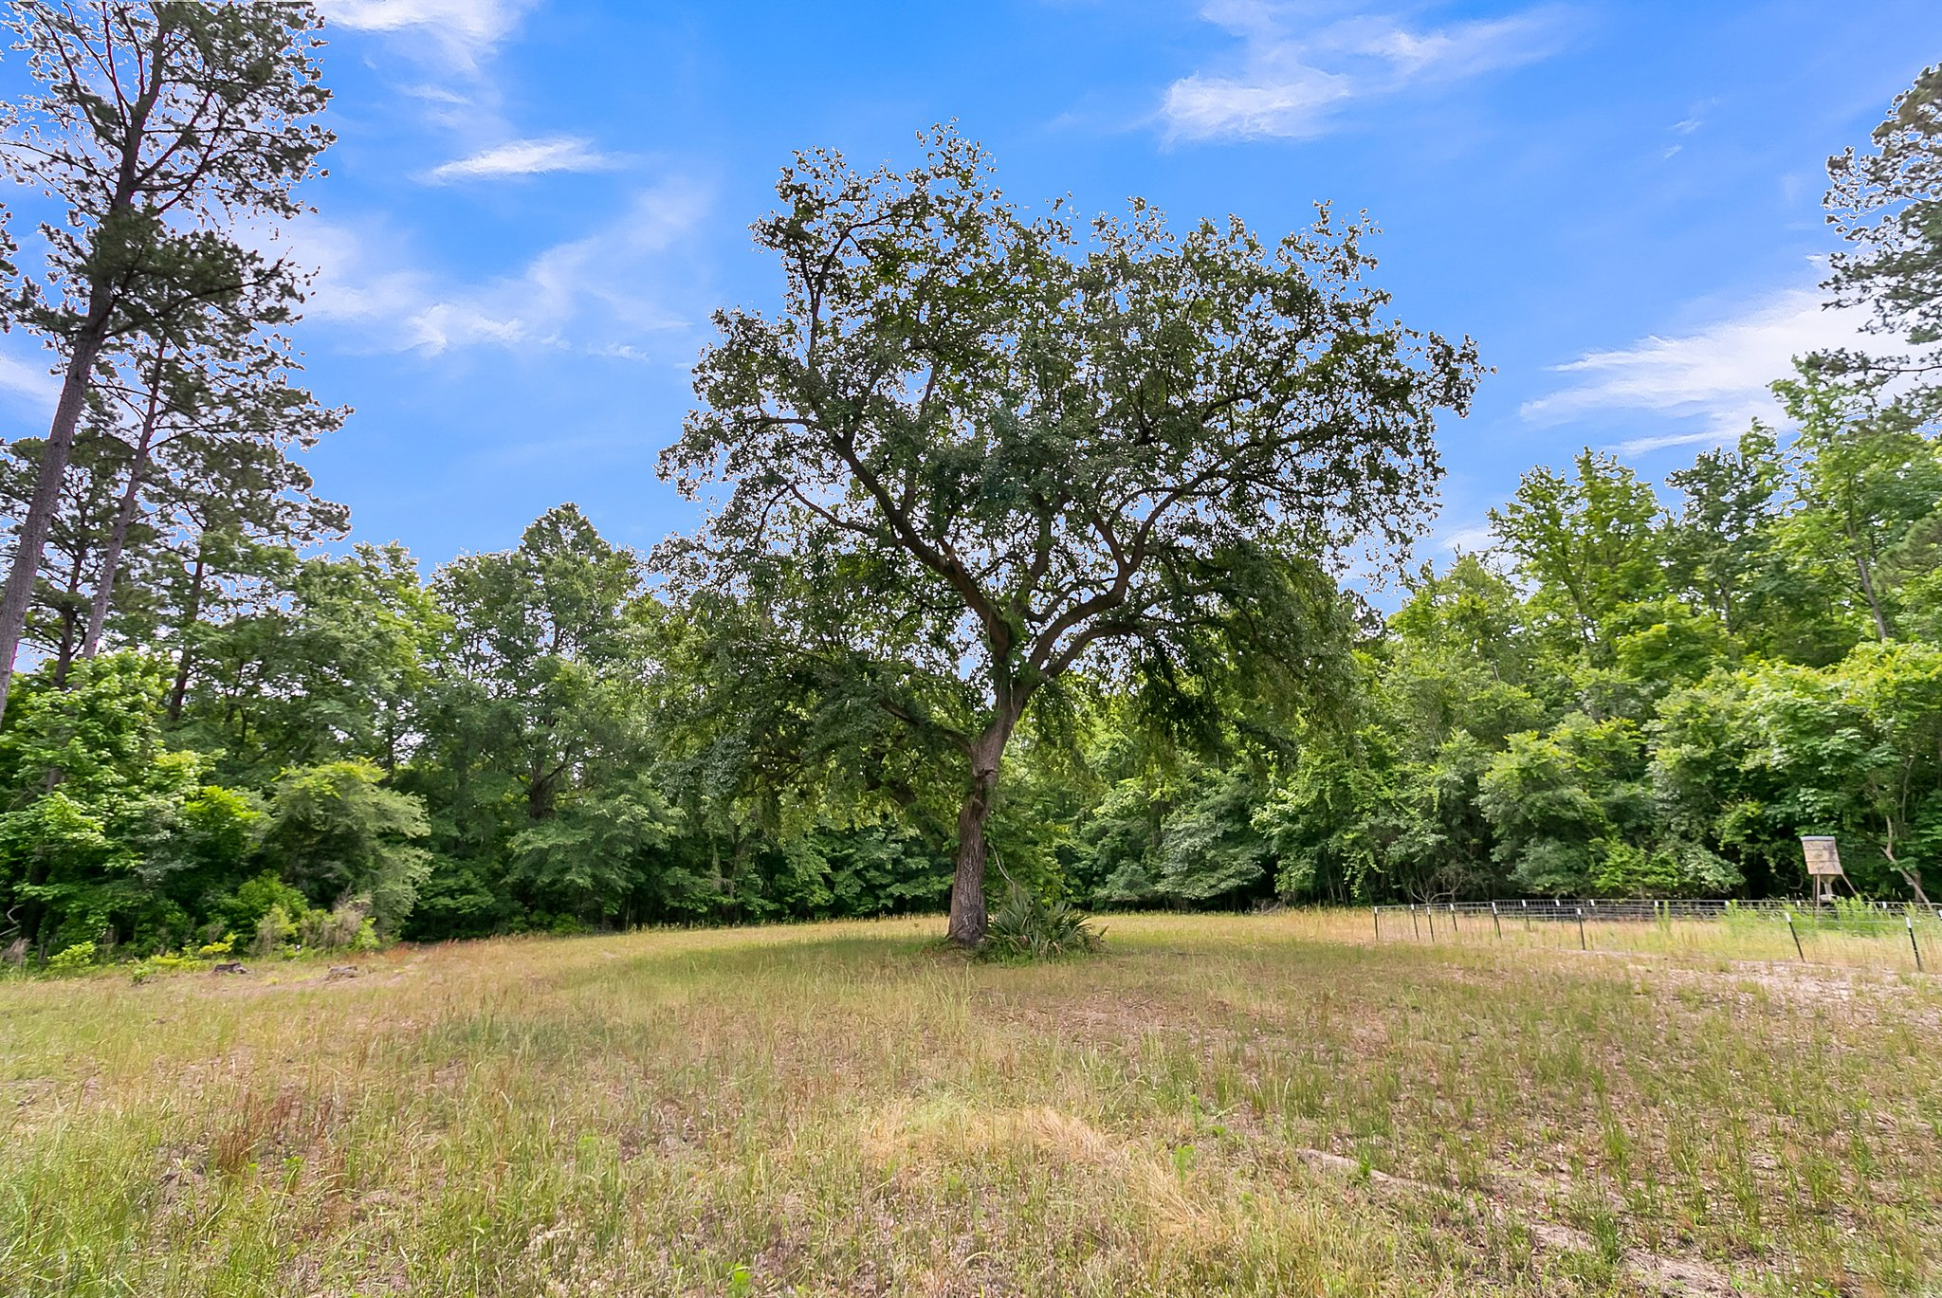
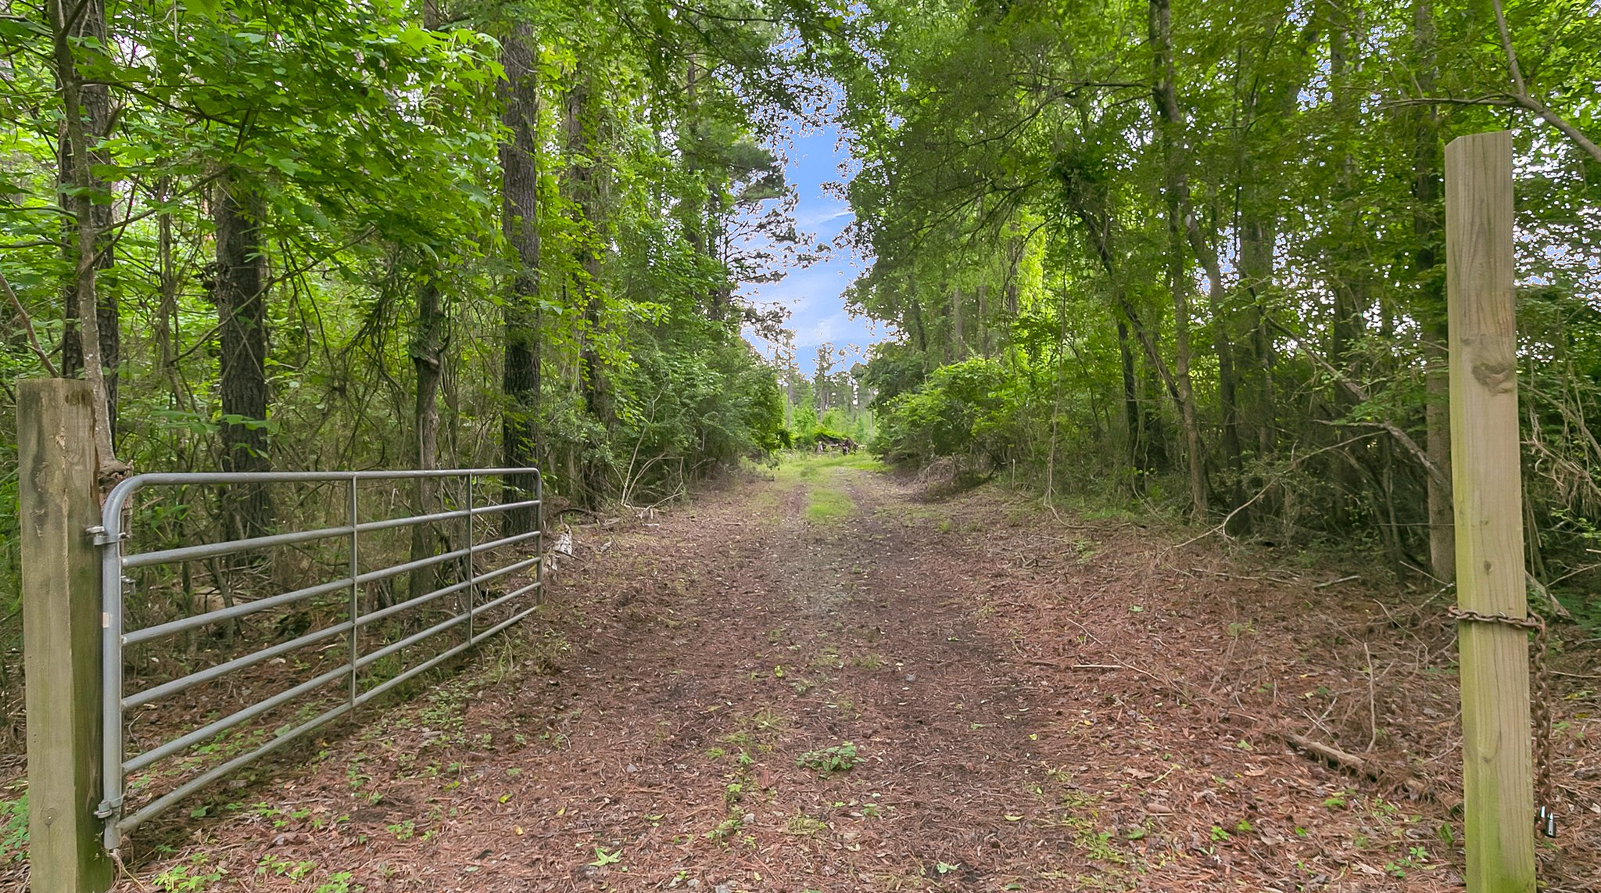
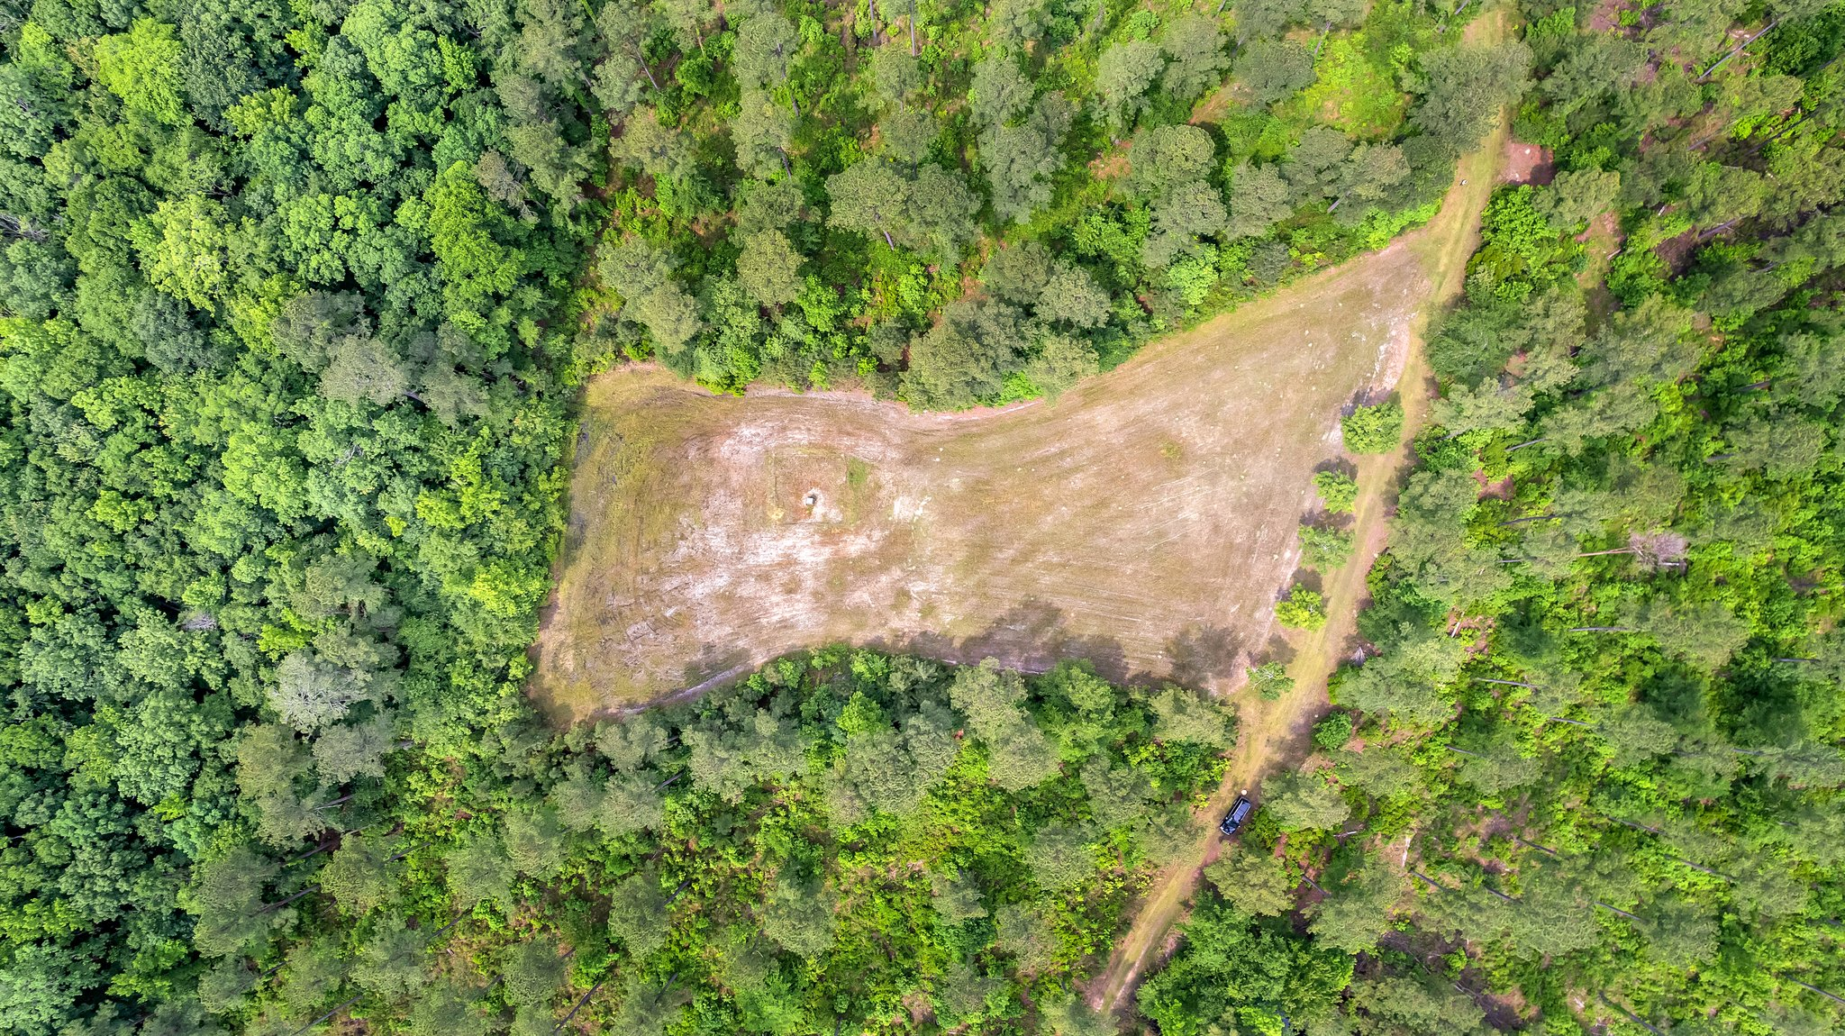
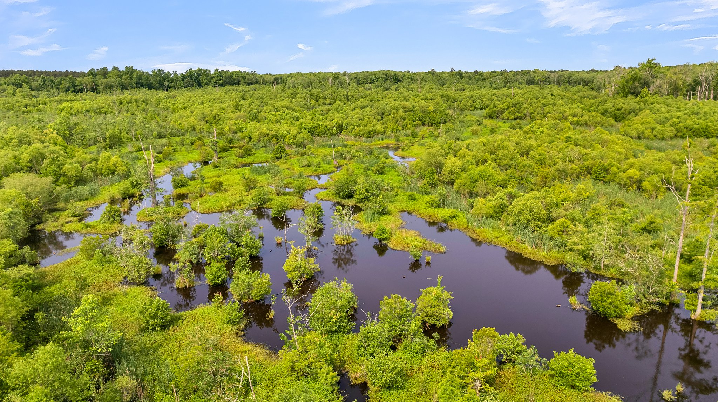
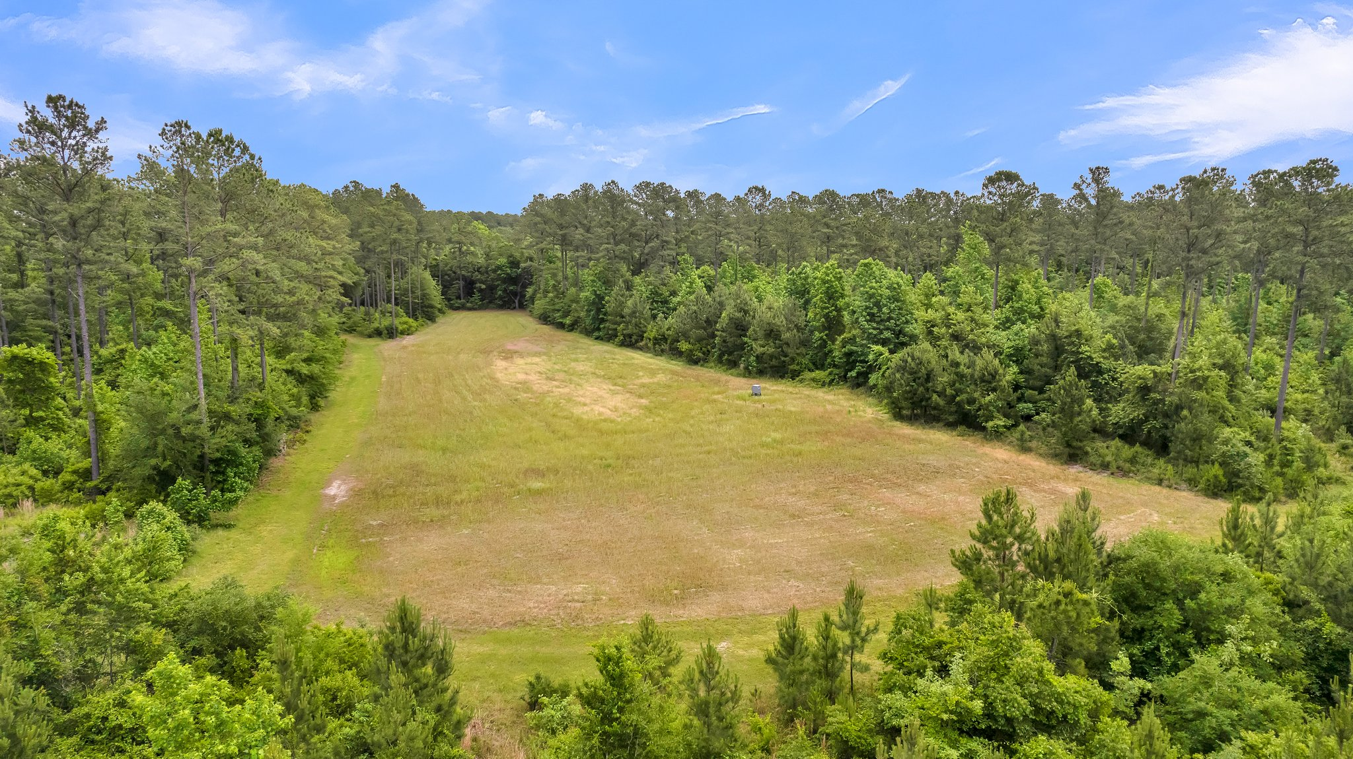
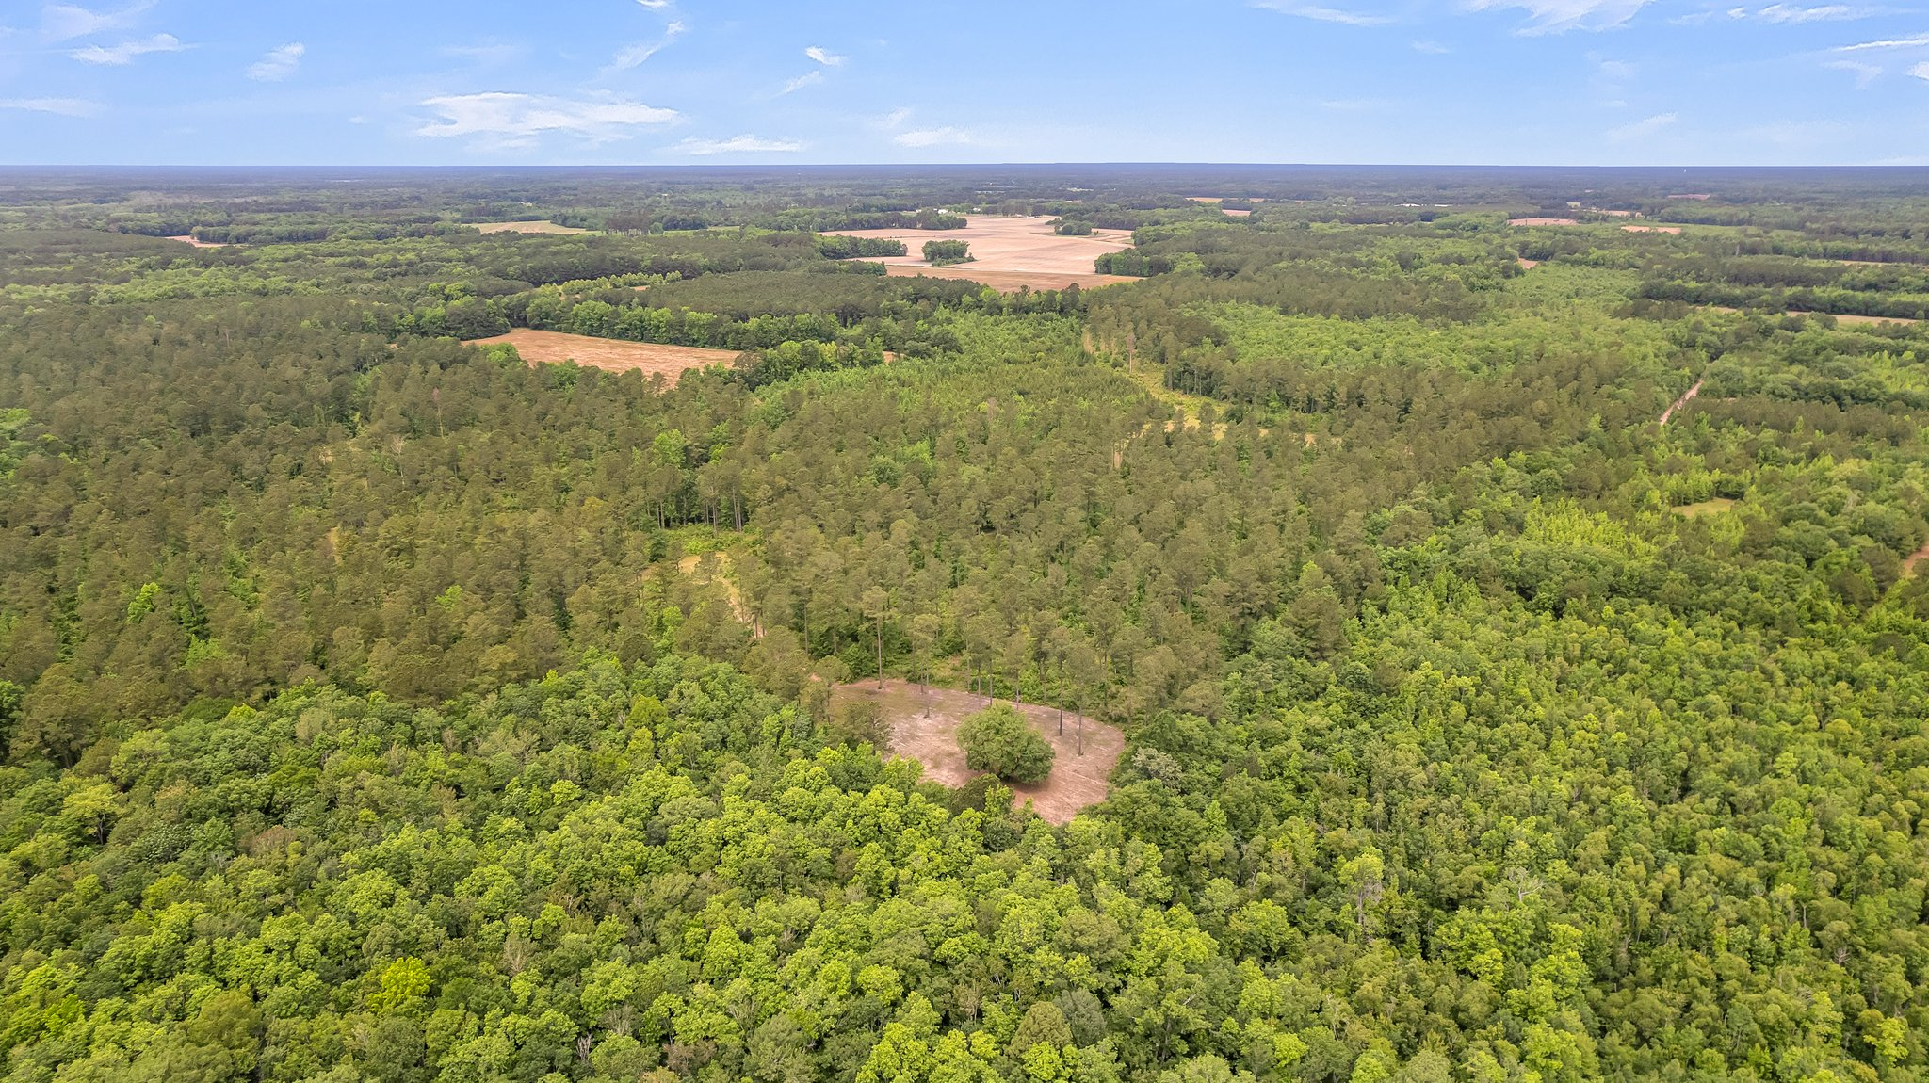
DOUGLAS CUTTING
(843) 534-3911
dcutting@bluewingproperties.com
bluewingproperties.com
Dutch Neck Farm
WILLIAMSBURG COUNTY, SC | $1,050,000
Located on a quiet stretch of road in Salters, SC near the Black River, this farm is a great example of Williamsburg County wildlife density and diversity. It’s a deer, turkey, and duck neighborhood, and the tract’s habitat accommodates all three. With numerous food plots, varying ages of pine timber stands, hardwood edges, bays, and beaver ponds – Dutch Neck Farm is a game magnet. The surrounding landowners have done an excellent job managing their properties, making this a desirable swath of Black River country.
Multiple species of ducks have been killed in the open swamp, and decades of buck and gobbler memories still linger in the woods and fields – including numerous “firsts” for kids! Most importantly, Dutch Neck Farm is a peaceful, convenient getaway, minutes from the historic Cooper’s Store or downtown Kingstree. It’s a comfortable hour-fifteen drive from the Charleston or Georgetown areas, but plenty far enough to feel like you’re in a different world.
VIDEO TOUR | PROPERTY WEBSITE

