Slide 1

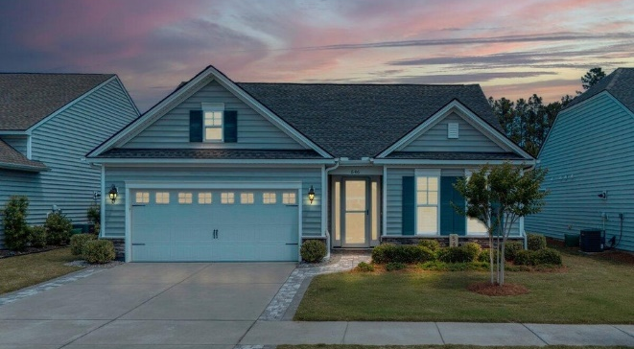

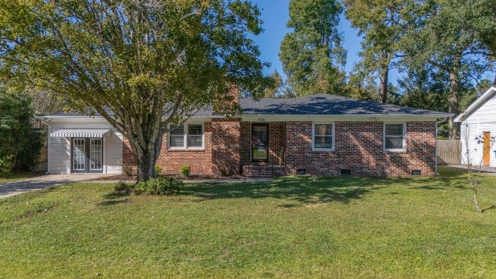

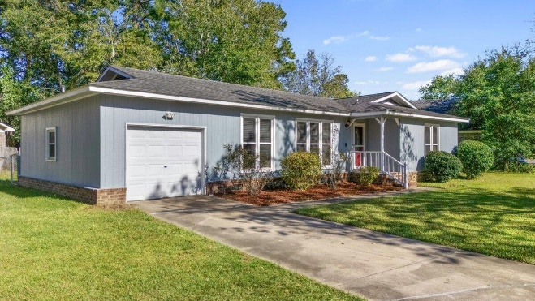
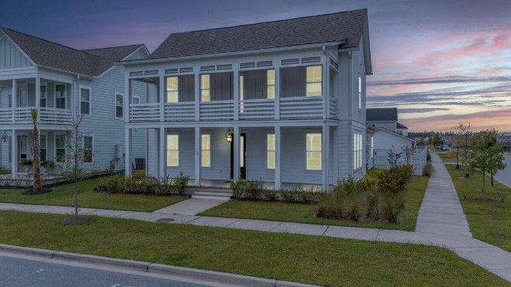



546 Four Seasons Blvd Cane Bay Plantation MLS# 24027874 | $524,900 3 Bed | 2½ Bath | 1,817sf $1,500 Agent Bonus w/ Acceptable Offer by 12/1
Darrell Creek Elevated Home With Elevator & Salt Pool
FEELING THANKFUL & FULL OF HOLIDAY CHEER
AND I WANT TO EXTEND THAT TO MY FELLOW AGENTS
WITH AN AGENT BONUS ON THESE FEATURED LISTINGS!
1516 Birthright St
Ashley Hall Manor
MLS# 24028808 | $624,900
5 Bed | 3 Bath | 2,540sf
$1,500 Agent Bonus w/ Acceptable Offer by 12/1
115 Three Wood Ln
Corey Woods
MLS# 24026412 | $320,000
3 Bed | 2 Bath | 1,404sf
$1,500 Agent Bonus w/ Acceptable Offer by 12/1
369 Baritone Rd Nexton
MLS# 24026192 | $659,900
3 Bed | 2½ Bath | 2,584sf
$1,500 Agent Bonus w/ Acceptable Offer by 12/1
Elissa Campbell
843-853-1433 | elissa.campbell@agentownedrealty.com
AgentOwned Realty Preferred Group | 824 Johnnie Dodds Blvd | Mt Pleasant, SC 29464

