Slide 1
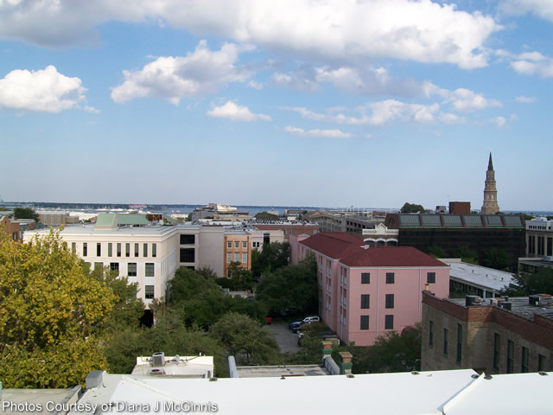



Do you get what you need for success?
Now interviewing both experienced and newly licensed agents.
Work with us and have an office you enjoy going to.
We have relocation client leads to work.
A Broker who will support, guide and coach you.
Contact Jan Miller at 843-345-9719 for a confidential interview.
Jan Miller, BIC
843-345-9719 | jmm619@comcast.net
www. erawilderrealty.com
ERA Wilder Realty, 125-F Wappoo Creek Dr, Charleston, SC 29412

