Slide 1
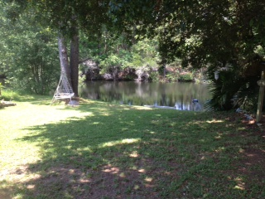
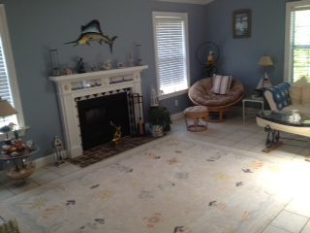
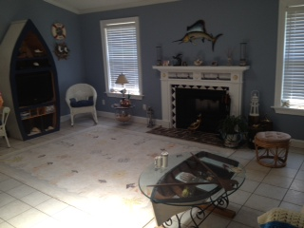
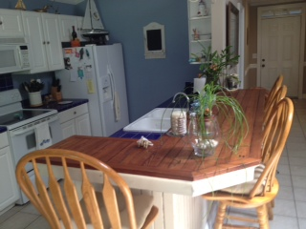
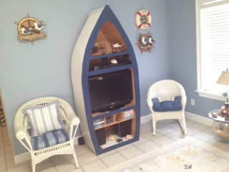


Pocket Listing
East Crossing Subdivision
3 BR, 2 Baths :: 1-Story :: On Pond :: 1-Car Garage
Immaculately Clean :: "Beach Theme" Painting & Decor
Used As A Second Home
Floors all Tile & Laminate :: Nice Re-Faced Kitchen Cabinets
Available showing hours: Thurs 6/23 2-6PM, Fri 6/24 11AM - 6PM, Saturday 6/25 11AM-2PM
Call Me @ 843.819-4951 to Arrange Showing
$327,900 List Price (3% Co-Op Commission to Buyer's Agent)
John Crowley
843-819-4951
John.Crowley@AgentOwnedRealty.com
AgentOwned Preferred Group | 1400-G Palm Blvd | Isle Of Palms, SC 29451

