Slide 1
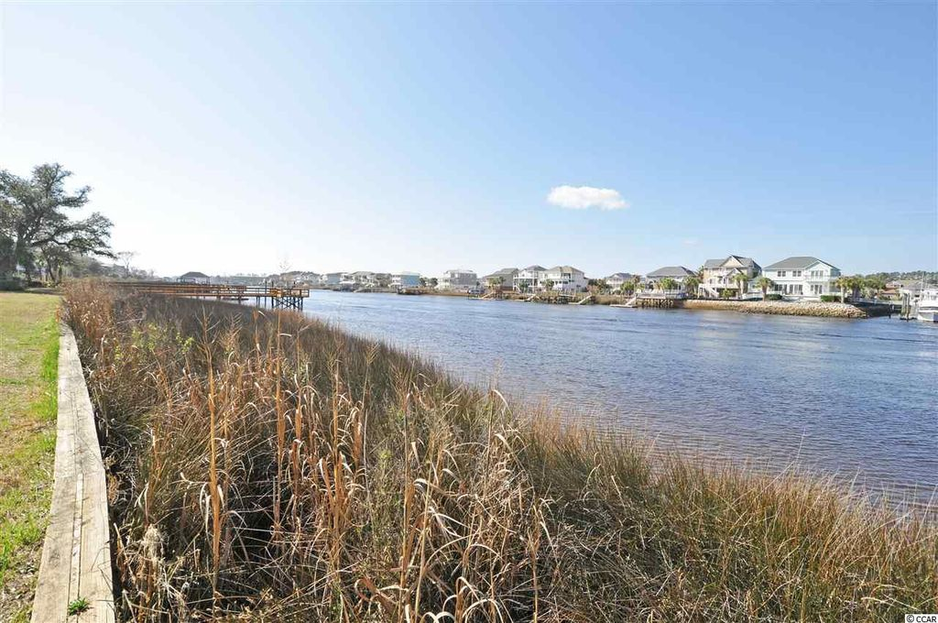
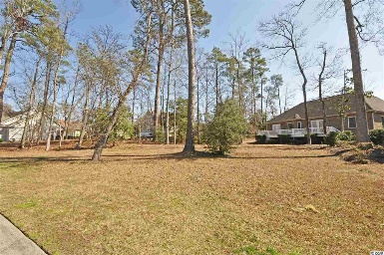
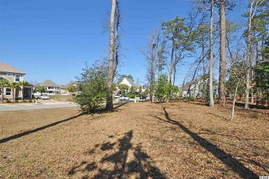
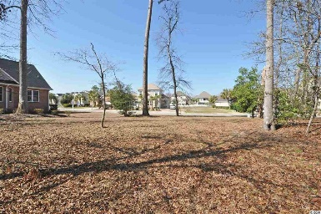
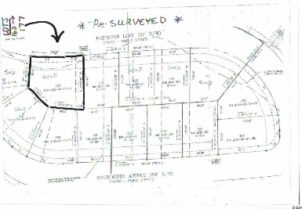
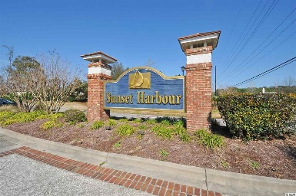
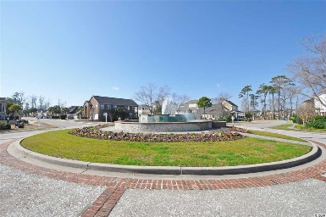
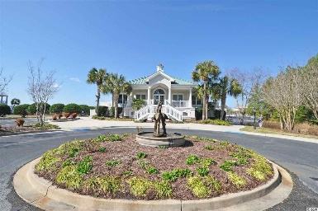
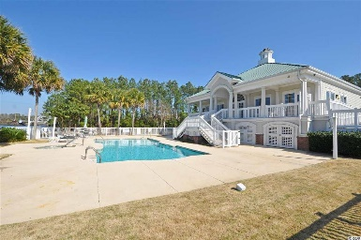


Boaters' Paradise In Upscale ICW Community
Eastover Ln (Lot 177)
Sunset Harbour
North Myrtle Beach, SC 29582
MLS# 1703795
$79,500
This lovely, OVERSIZED wooded lot is located in an upscale community of luxury homes - private yet in close proximity to restaurants, shopping and a 5 minute drive to the ocean! The lot parcel boasts road frontage of 102 feet as compared to the standard lot frontage in Sunset Harbour of approximately 55 - 65 feet. Overall lot size is greater as well. Amenities include clubhouse, pool, boat launch AND boat storage! Complex boasts beautiful landscapng and various small lakes throughout. Build your dream house now at a most attractive initial investment. There is no stipulated time frame during which one must build on this lot following purchase. In addition, owner will furnish a complete set of plans for a luxury home which can be build on site.
Deborah Collins
843-424-9013
dctidewater@yahoo.com
Connie Ross-Karl
702-306-2643
conniesross@aol.com
NEW WAY PROPERTIES MYRTLE BEACH

