Slide 1







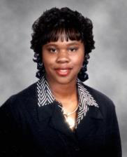
You’re Invited!
Come celebrate the Grand Opening of our new office!
When: Saturday from 5-7p | RSVP: (843) 452-3779
Where: 8310-A Rivers Ave., North Charleston, SC 29406 (Across from Crew's Chevrolet)
Mattie Nesmith (Broker-in-Charge) AGENTS
Lathaniel Ford Tiffini Ford-Lockwood Kenneth Lafayette Lacreshia Geddis James E. Hall | Roz Parker Cornelius Shepherd Michael Waites Kimberly Waters Nick Waters (Assistant)
Mattie Nesmith
Broker-in-Charge
C 843-452-3779
F 866-472-1514
mattie@ergroupofsc.com
Caribbean Food Catered by Cocktails & Canapae's
Jump Castle provided by
Plan it Fun
The Elite Realty Group of SC, LLC
3618 Ashley Phosphate Rd
Suite 3
North Charleston, SC 29418
www.ergroupofsc.com

