Slide 1
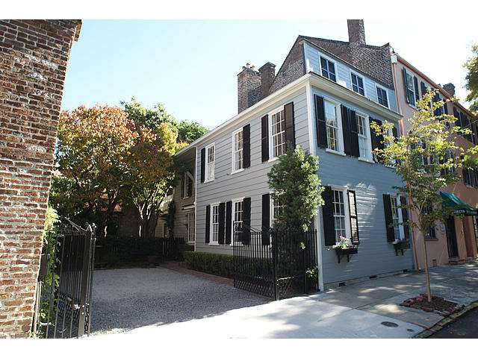
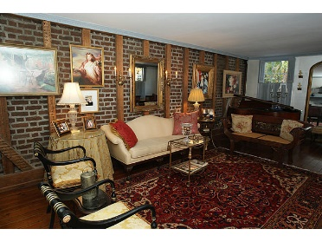
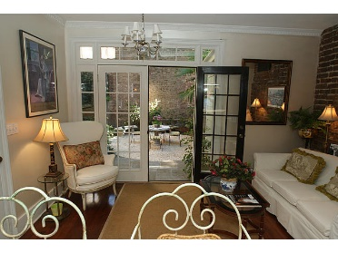
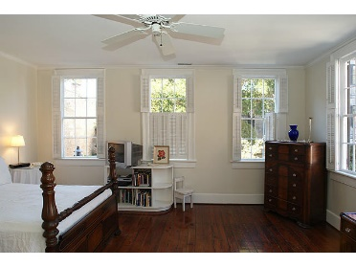
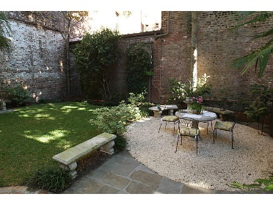
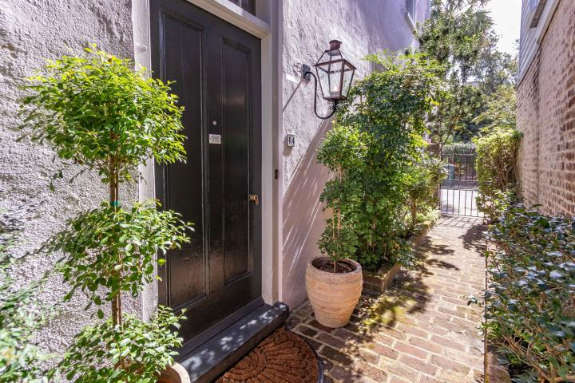
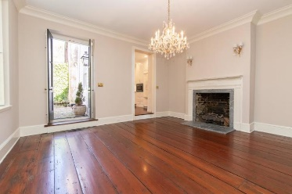
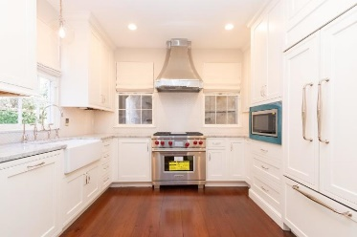
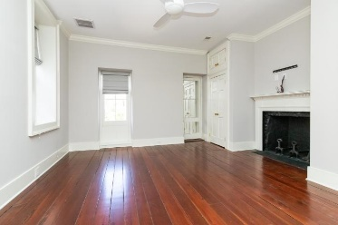
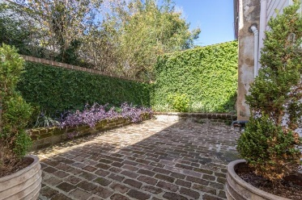

26 State Street MLS# 18028128 ~ $1,849,000
Just Reduced $785,000!
French Quarter Open Houses
Wednesday, March 6th
11:30-1:30
Ellen Leigh Murray
Charleston Premier Properties
843-813-2006
chaspremierprop@bellsouth.net
14 Queen Street MLS# 18029098 ~ $1,995,000
Cheryl Kaynard
Handsome Properties, Inc
828 -216-5713
cheryl@handsomeproperties.com

