Slide 1
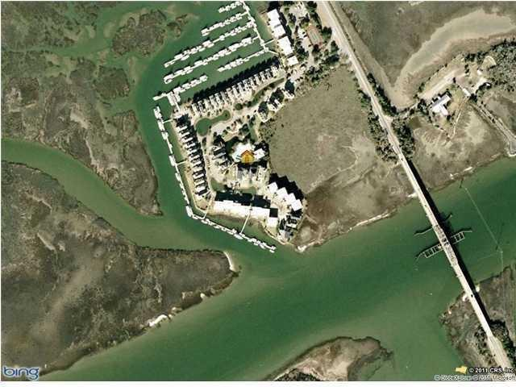


Includes Boat Slip with Direct Access to Harbor & Ocean
G-5 Ben Sawyer Blvd Tolers Cove
Tolers Cove - Mount Pleasant, SC 29464 - MLS# 15002522 - $115,000
Boaters, Fishermen & Yachtsmen get ready for warm weather & please take note of this great 35 foot BOAT SLIP location at gated Tolers Cove Marina!
No more trailering or waiting for Bridge openings to access off-shore fishing or cruising - direct access to Atlantic Ocean, IntraCoastal Waterway AND Charleston Harbor!
Fuel dock with ice & light provisions * Water & Electric included * More affordable than deep water lot with dock * Your own boat slip - A Boat owner's ''MUST HAVE'' for complete boating enjoyment!
Sheila Romanosky
(843) 224-0242
sromanosky@carolinaone.com

