Slide 1
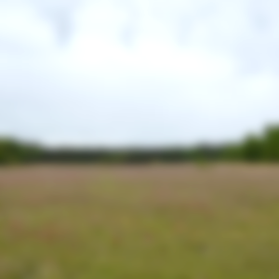
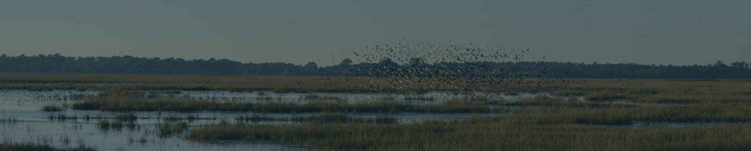

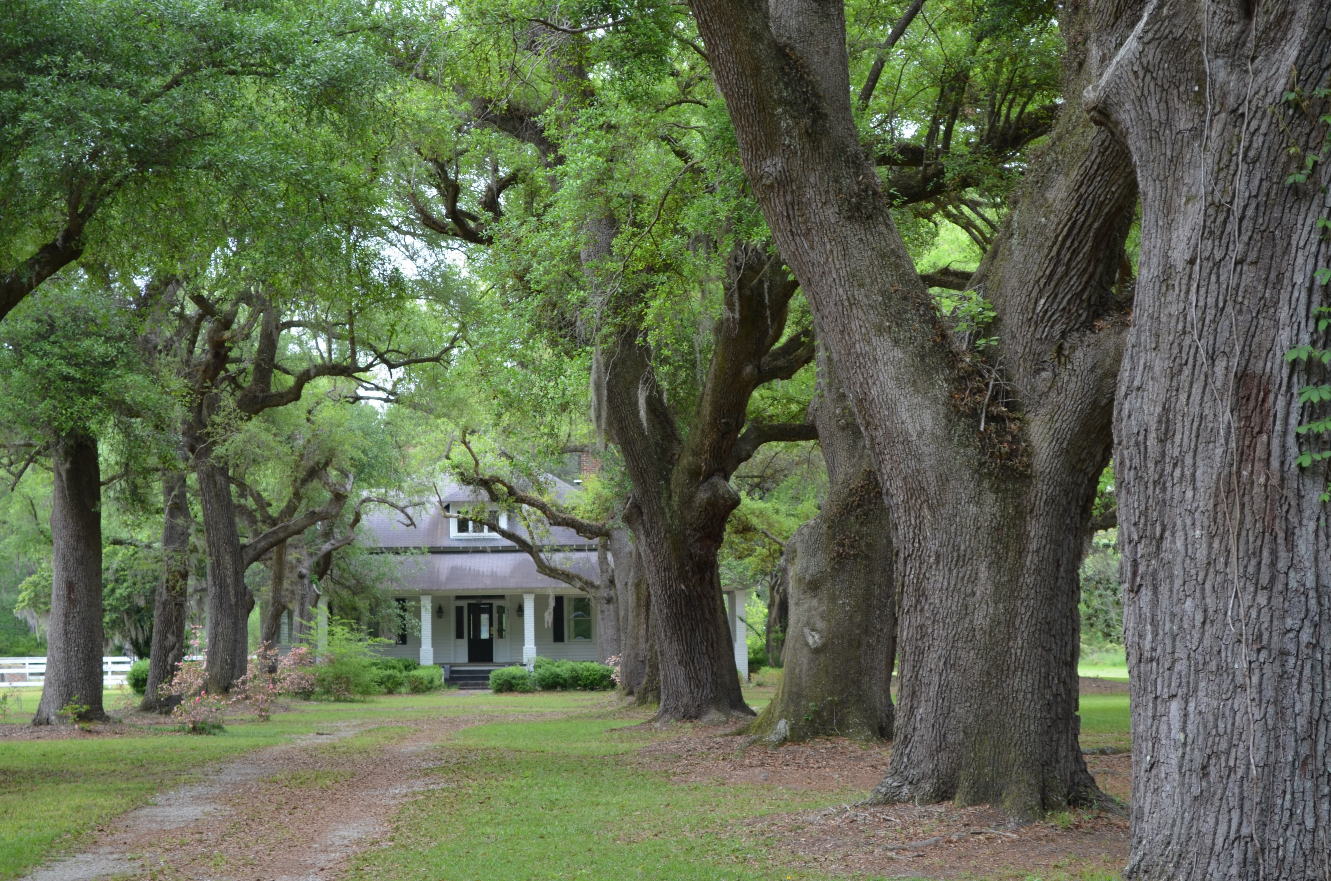
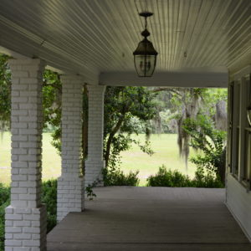
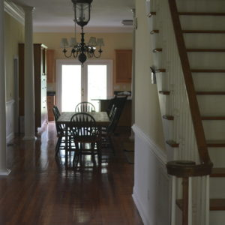
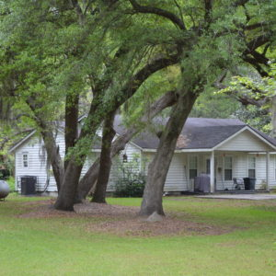
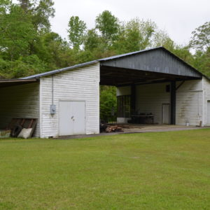
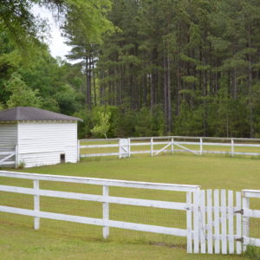
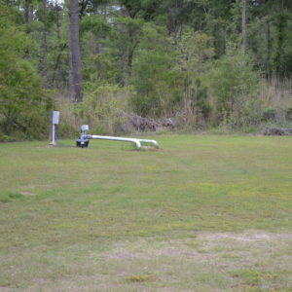
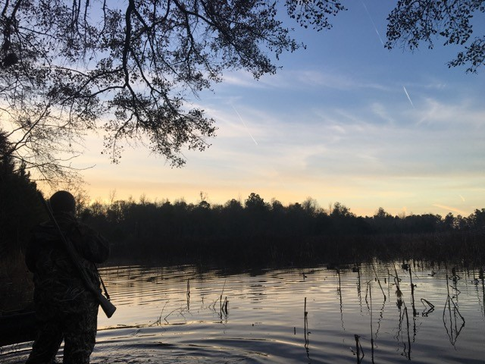
DOUGLAS CUTTING
(843) 534-3911
dcutting2@gmail.com
Galilee Plantation
Holly Hill, SC ~ Orangeburg County
271 Acres ~ $2,500,000
Sitting in a quietly growing waterfowl area between Holly Hill and Eutawville, SC, Galilee is an attractive turn-key hunting farm within easy reach of Charleston. The five-bedroom house was built just after the Civil War and has been refurbished into a handsome hunting lodge with modern amenities, hardwood floors, and numerous fireplaces. There is a pole-shed complete with walk-in cooler as well as a caretaker’s dwelling on the property.
50 acres of duck impoundments are currently being planted with rice and/or corn and are flooded with well and pump systems. Excellent upland hunting is a nice bonus to the ducks, which have been supplemented with release mallard programs through the years.
This property does not have a conservation easement.

