Slide 1
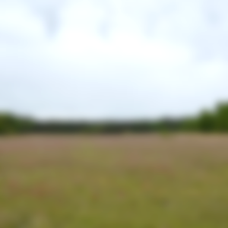
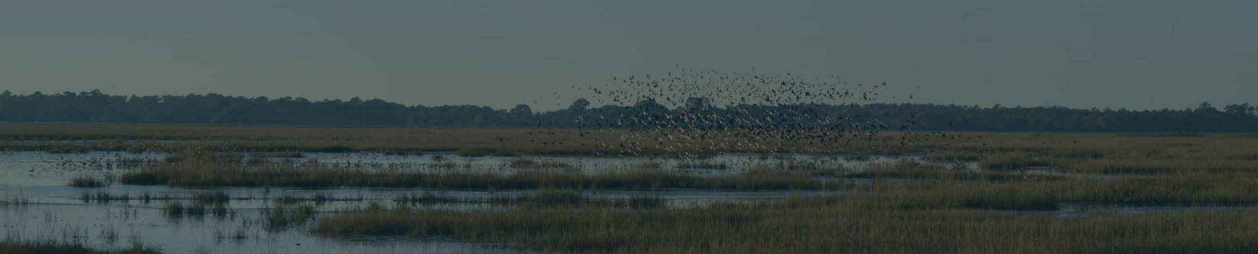

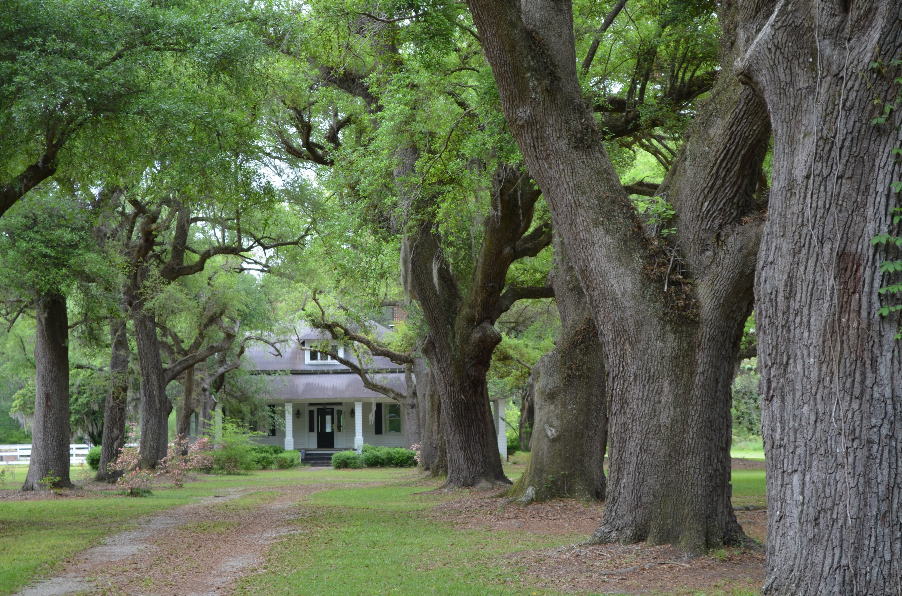
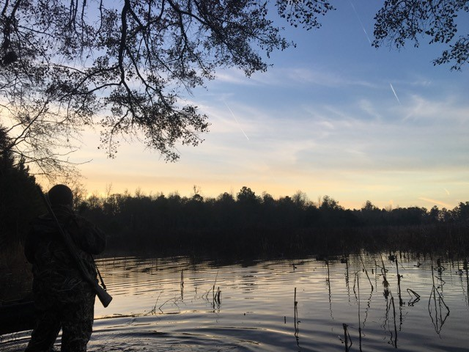
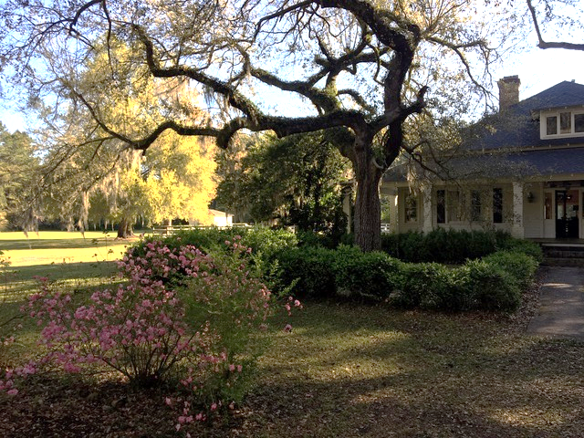
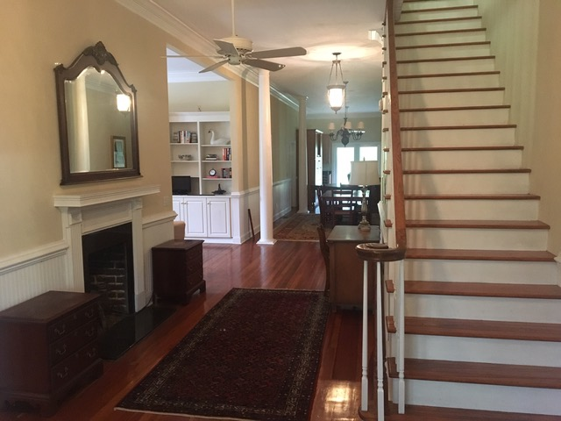
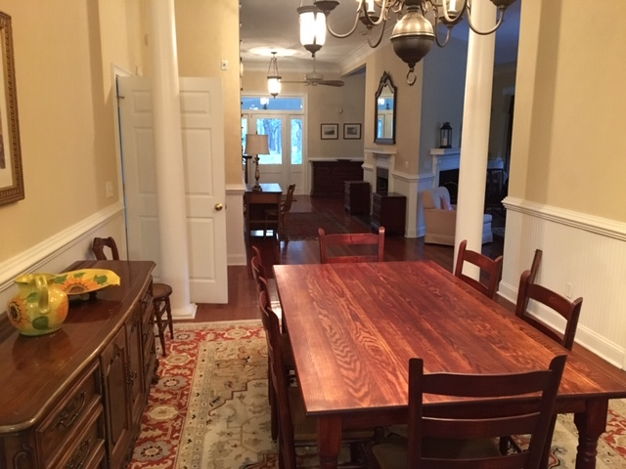
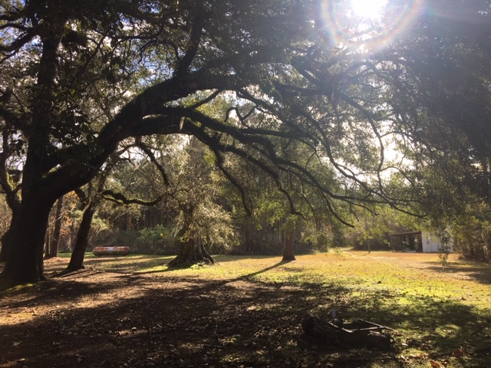
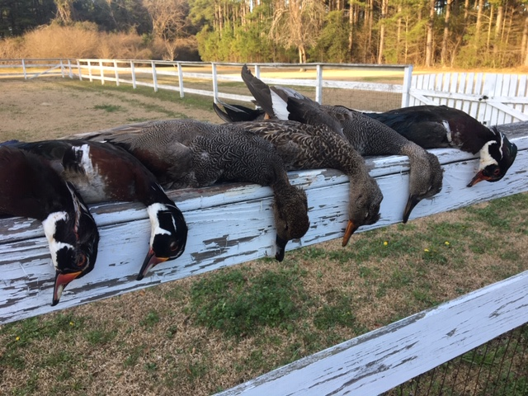
DOUGLAS CUTTING
(843) 534-3911
dcutting2@gmail.com
bluewingproperties.com
Galilee Plantation
Holly Hill, SC ~ Orangeburg County
271 Acres ~ $2,200,000
Sitting in a productive waterfowl area between Holly Hill and Eutawville, SC, Galilee is an attractive turn-key hunting farm within easy reach of Charleston. The five-bedroom house was built just after the Civil War and is now offered as a fully-furnished home and/or hunting lodge with modern amenities, hardwood floors, and numerous fireplaces. There is a pole-shed complete with walk-in cooler as well as a caretaker’s dwelling on the property. 50 acres of duck impoundments are currently being planted with corn and chufa and are flooded with well and pump systems. Excellent upland hunting is a nice bonus to the ducks, which have been supplemented with release mallard programs through the years. This property does not have a conservation easement.

