Slide 1
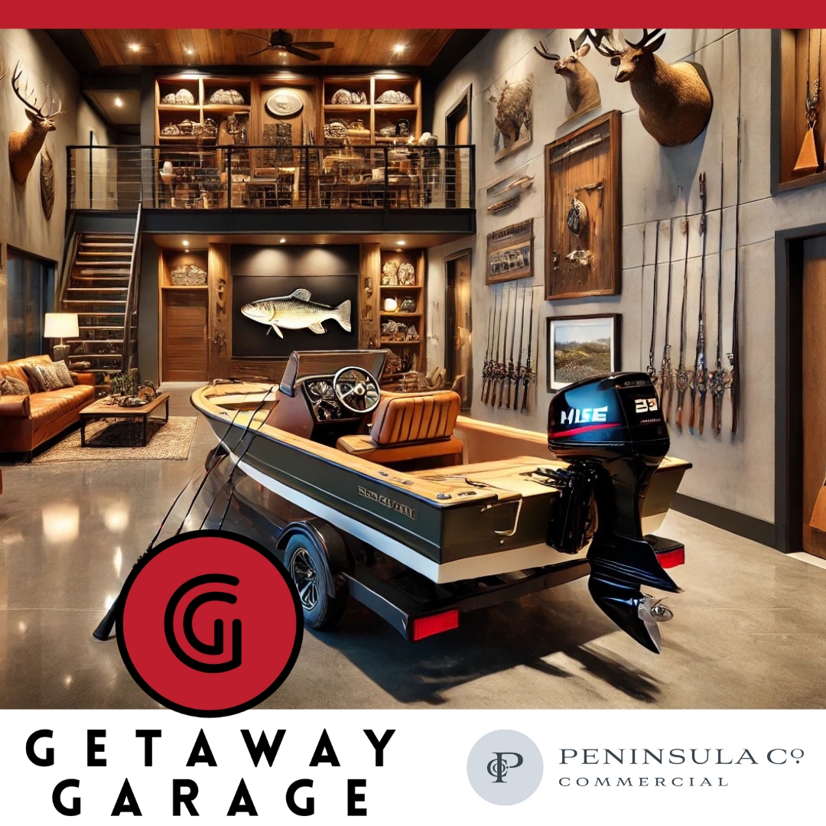

Imagine a private, fully customizable garage suite where you can store your boat, gear, and off-road toys—all in one secure, high-end space designed just for you. At Getaway Garage, we’re offering Luxury Garage Suite Condos built for those who live for the outdoors.
Boating Enthusiasts: Keep your boat and watercraft safe, secure, and ready for the next adventure. With spacious storage and climate-controlled options, your investment stays in pristine condition.
Hunters & Outdoorsmen: Need a private retreat for your hunting gear, ATVs, and outdoor equipment? Customizable loft spaces allow you to create a dedicated hunting lodge with everything you need for the season.
Why Getaway Garage?
✔ Secure, private garage suites with customizable layouts
✔ Room for boats, ATVs, hunting gear, and more
✔ Convenient location near Charleston’s top boating & hunting destinations
✔ Pre-sale pricing starting at $299K—limited availability
Whether you’re chasing the next big catch or gearing up for hunting season, this is your space to own. Secure yours before they’re gone!
Reserve Your Garage Suite Today
See you on the water (or in the woods),
The Getaway Garage Team
📍 5030 North US Highway 17, Awendaw, SC 29429
📞 803.824.0773

