Slide 1
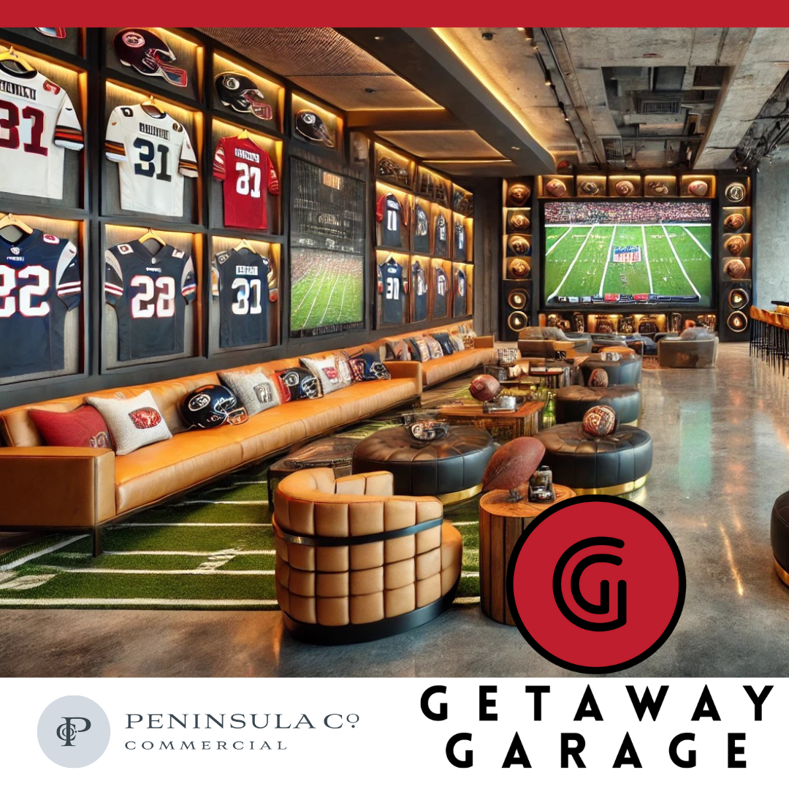

Imagine having the perfect game day retreat—a private, luxury garage suite where you can store your prized possessions and host the ultimate tailgate party all in one place. At Getaway Garage, we’re giving sports fans like you the chance to own a customizable garage condo that doubles as the perfect man cave escape.
Clemson Fan? Picture a Tigers-themed lounge, decked out in orange & purple, where you and your friends can watch every game in style.
Gamecocks Diehard? Create your own garnet & black sports bar, complete with a big-screen TV, kegerator, and plenty of space for your memorabilia.
Your Game Day Retreat Includes:
✔ Private, high-end garage suites—store your cars, tailgate gear, and collectibles
✔ Customizable interiors—add a lounge, bar, TVs, and sports décor
✔ Climate-controlled comfort—watch the game in style, rain or shine
✔ Secure & exclusive ownership—this is your space, designed your way
✔ Pre-sale pricing starts at $299K—limited availability!
Whether you’re tailgating at Death Valley, Williams-Brice, or hosting the best watch parties in town, this is your space to own.
Claim Your Luxury Garage Suite Now
See you on game day,
The Getaway Garage Team
📍 5030 North US Highway 17, Awendaw, SC 29429
📞 803.824.0773

