Slide 1
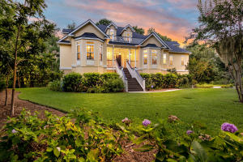
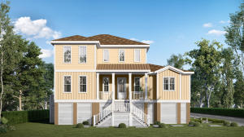
Gift Plantation Broker Open House - Thursday 11-1
Lunch Provided By Fairway Mortgage ~ $50 Gift Card Giveaway
Stop in for Lunch
3890 Sweetbriar Court
MLS# 20022245 | $875,000
4 Bedrooms | 2 Baths | 4,274 Square Feet
Anthony Carlomany
336-813-5637 | acarlomany@mattoneillteam.com
Matt O'Neill Real Estate
End with Dessert
3907 Plantation Lakes Drive
MLS# 20003538 | $895,200
4 Bedrooms | 3½ Baths | 2,984 Square Feet
Jonathan Bianco
843-906-5122 | jjbianco1267@gmail.com
Carolina Elite Real Estate

