Slide 1
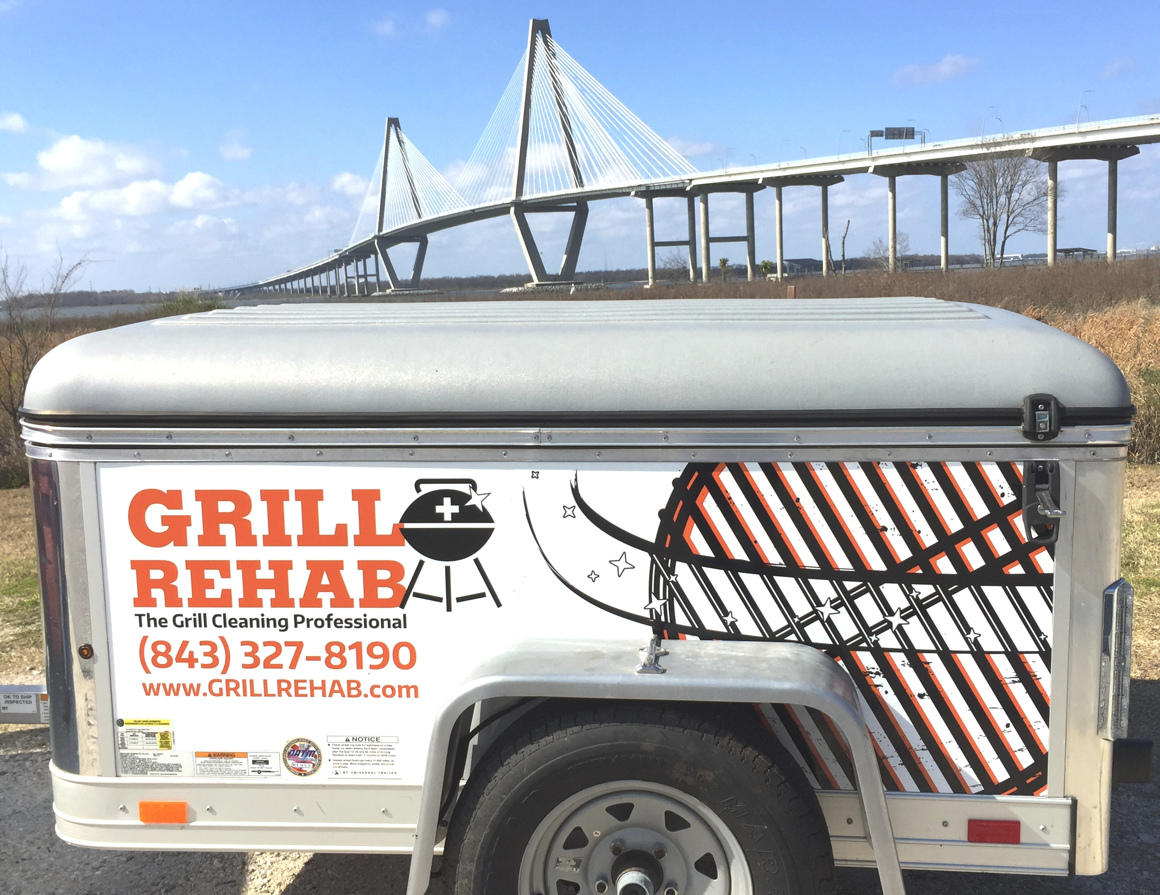

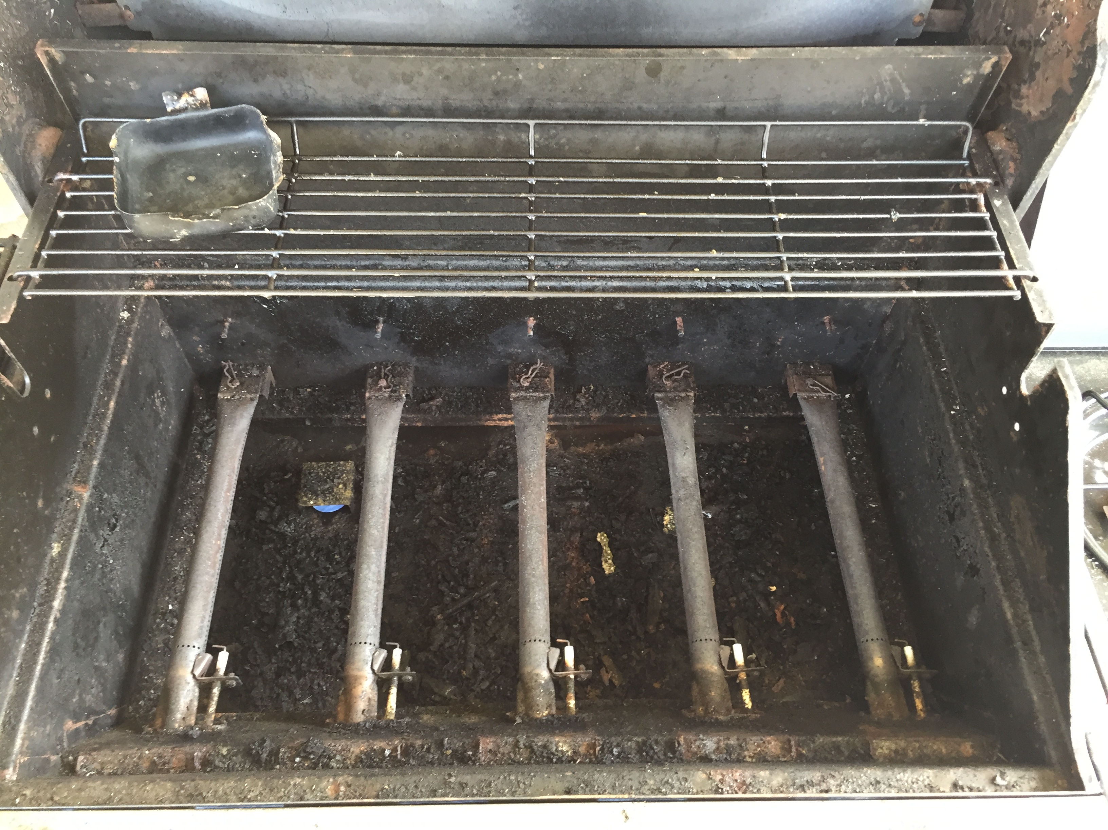
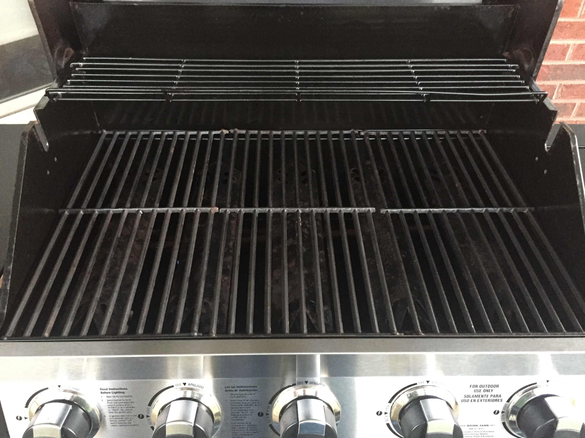
Locally owned and operated by Morgan Aycock
According to the National Fire Protection Association:
From 2009-2013, fire departments responded to an average 8900 home fires involving grills. The leading causes of grill fires were a failure to clean!
Grill Rehabs unique grill cleaning process provides many benefits for grill owners including:
Removing harmful carcinogens and charred particles that can be passed on to food.
Professionally cleaning burners and interior parts to improve performance, prevent future corrosion, and prolong the life of your investment.
Removing stubborn grease deposits, drastically reducing the risk of a dangerous grease fire.
‘
Before
After
Ask about volume discounts for property management services with multiple grills.
Call/Email me today!
843.327.8190
grill.rehab@gmail.com | www.grillrehab.com
271 Alexandra Dr. #9 | Mt Pleasant, SC 29464

