Slide 1
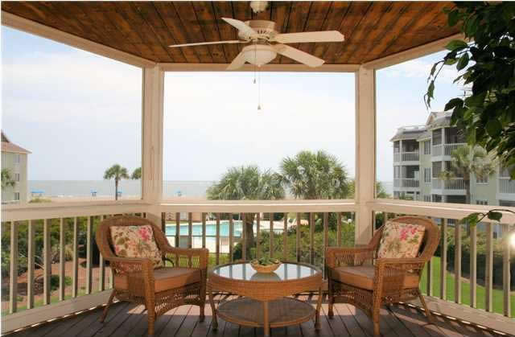
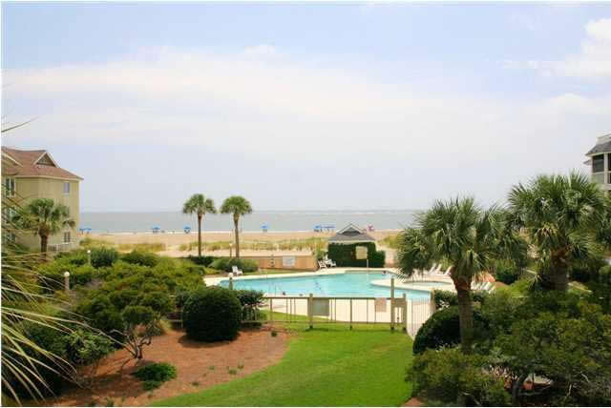
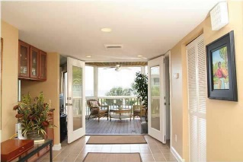
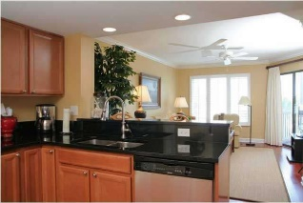
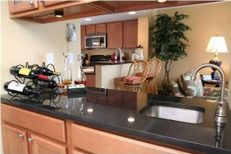
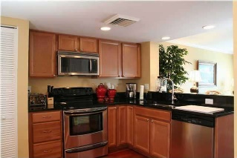
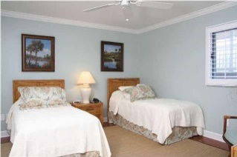
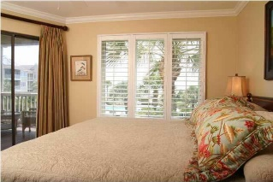


202 Tidewater H202
Wild Dunes
Isle of Palms
MLS# 1303830
$629,900
Absolutely Oceanfront!!!
New Price!
Incredible views from the Screened Porch, living room and bedroom! This luxurious villa in Wild Dunes has been totally renovated with exquisite attention to detail, professionally decorated by local designer. Kitchen was totally reconstructed to provide a better flow. Granite counter tops, stainless steel appliances, beautiful wood floors, and the kitchen is open to the living area. Bathrooms features marble floors, custom shower and surrounds. Fabulous rental--expect 90% rental rate for 2015 and 1st quarter of 2016 the same. This property is sold as seen, Fully Furnished, just bring your luggage and enjoy the serenity and beauty that is the best of the Beach! The complex at Tidewater has a wonderful outdoor pool area, boardwalk to beach, elevators, and is within walking distance to the Wild Dunes Golf Clubhouse. There is a .05% transfer fee based on the total sales price at closing to Wild Dunes HOA that is paid by the purchaser.
Darlene Smith
Office - (843) 886-8110
Mobile - (843) 696-7824
darlenesmith@carolinaone.com
DarleneSmithTeam.com
Carolina One Real Estate
1503 Palm Blvd Ste
Isle of Palms, SC 29451

