Slide 1
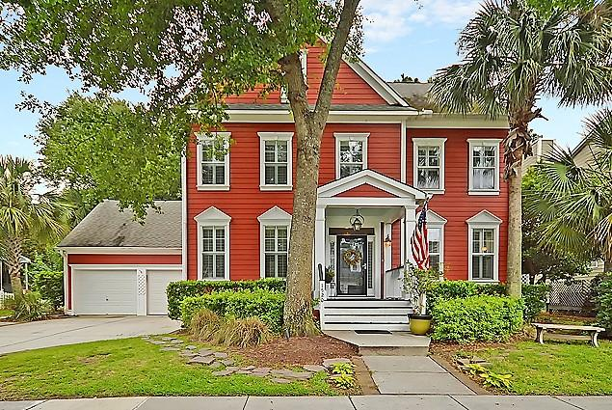
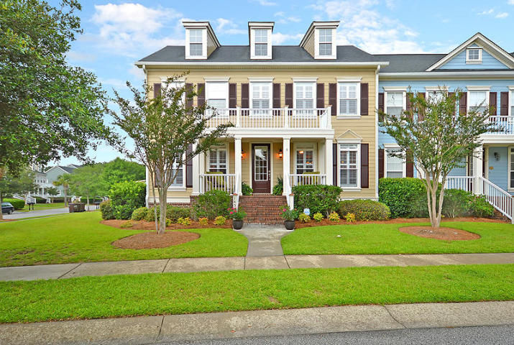
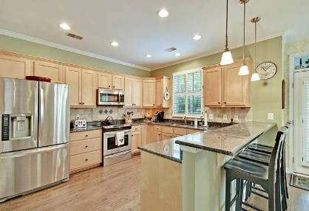
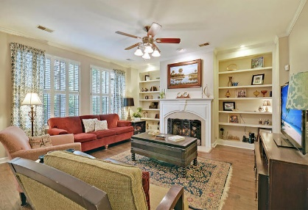
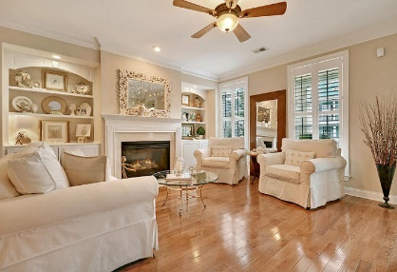
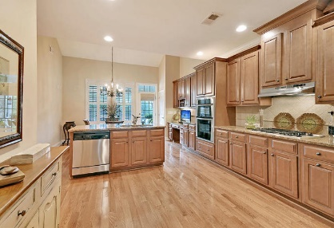
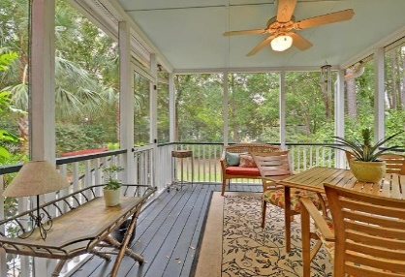
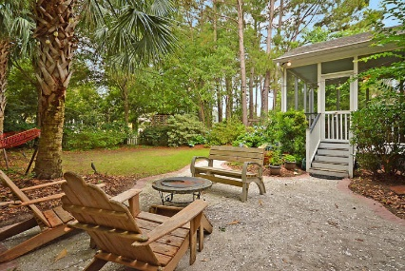
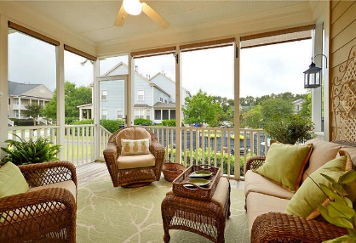
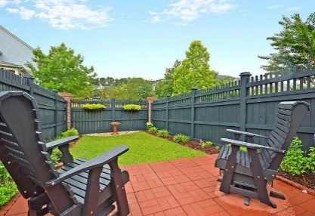
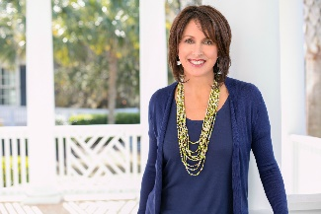

Hamlin Plantation Open Houses
Tuesday 7/24 ~ 12-2 pm ~ Drinks and snacks!
Visit both houses and leave your card to be entered in a $50 gift card drawing
1520 Faith Street
MLS# 18017656
$635,000
1453 Clancy Road
MLS# 18017670
$525,000
AgentOwned Premiere Group
824 Johnnie Dodds Blvd
Mt Pleasant 29464
Lauren Zurilla
(843) 991-9149
laurenismyrealtor@gmail.com
www.LaurenZurilla.com
Stan Huff & Jill Marcacci
Stan (843) 670-2835
Jill (843) 297-5590
stan.huff@agentowned.com
jill@agentownedrealty.com

