Slide 1
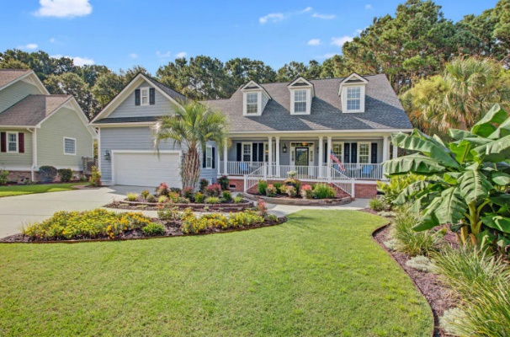
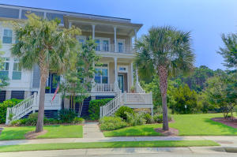
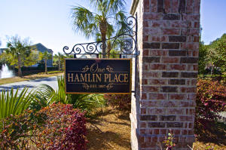
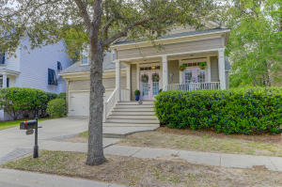
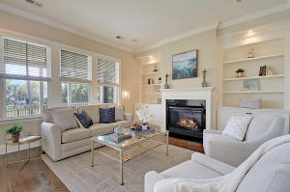
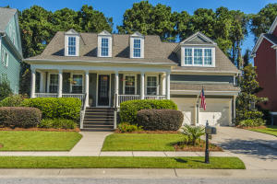
Hamlin Plantation Broker Open Houses
Thursday, September 19th, 2019
11am-1pm
Leave your business card to qualify for drawings
1433 Lagoon Park Circle
MLS#19023327
$825,000
Kathy Coulthard
Keller Williams
843.670.9923
Drawing for Fall Gift Basket
2028 Amenity Park Drive
MLS#19019839
$595,000
Brantlee de Brux
Carolina One Real Estate
843.697.9516
Serving Lunch & Drawing for Gift Card!
3030 Monhegan Way
MLS#19003719
$540,000
Laurel Cockfield
Carolina One Real Estate
843.817.2021
Drawing for Gift card!
3132 Treadwell Street
MLS# 19009404
$469,000
Lora Goolsby
Carolina One Real Estate
843.478.0177
Serving Dessert!
4228 Coolidge Street
MLS# 19021861
$680,000
Lauren Zurilla
Carolina One Real Estate
843.991.9149
Drawing for $50 Gift card!
4241 Coolidge Street
MLS# 19025128
$639,500
Lise Gulick
Carolina One Real Estate
843.998.1050
Serving Lunch!

