Slide 1
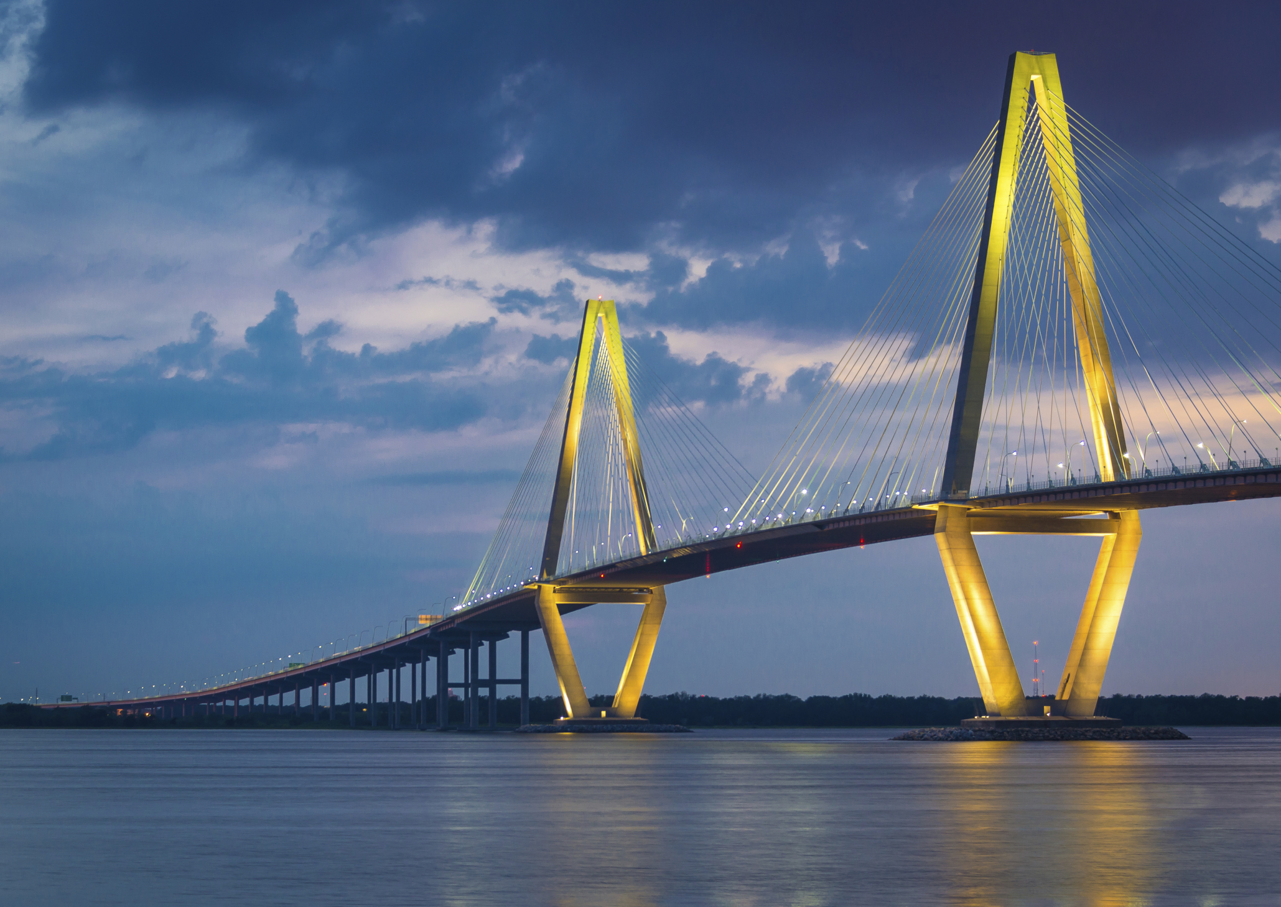

Offering: » Prime downtown Charleston office with parking & walk-in traffic » Fun, friendly small office atmosphere » Lead generation » Generous advertising budget for advertising and branding » Competitive commission structure » Extensive office support and knowledge to assist your needs » Opportunity to work with a growing company that is actively developing projects & seeking investment opportunities Seeking: » Motived team members that want to succeed » Professional full time real estate experts » Residential realtors with a successful track record » Commercial realtors who are experts in their field » Honest, friendly and ethical teammates
All inquiries are strictly confidential.
For more information, please call or email
Frank Thornhill
O 843.779.1277 | C 843.224.7997
fthornhill@hanlandevelopment.com
HanlanGroup.com
Hanlan Group is seeking motivated and knowledgeable individuals to complete our Real Estate team. We are looking for experienced Residential and Commercial Realtors that are experts in the Charleston market. Hanlan Group is a full service Real Estate brokerage firm located in downtown Charleston.

