Slide 1
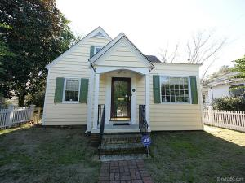
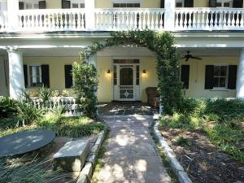
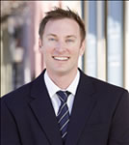

Harleston Village Open House
Saturday March 21st 12-2
137 Beaufain Street
MLS# 15000837 - $1,150,000
90 Ashley Avenue A
MLS# 15004763 - $775,000
Check out the virtual tour for more pix!
Check out the virtual tour for more pix!
Bradley O’Mara
Broker In Charge
armada202@gmail.com
Office: 843-442-8787
www.remaxelitecharleston.com
RE/MAX Elite | 91 Broad St | Charleston, SC 29401

