Slide 1
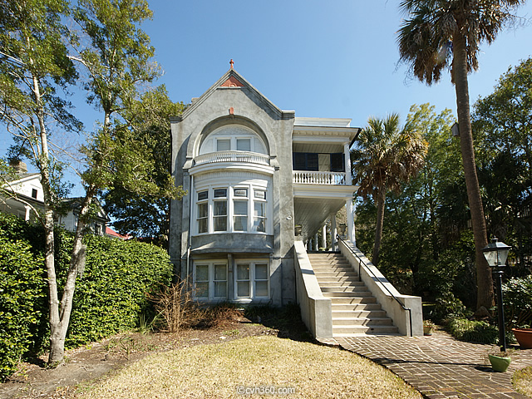
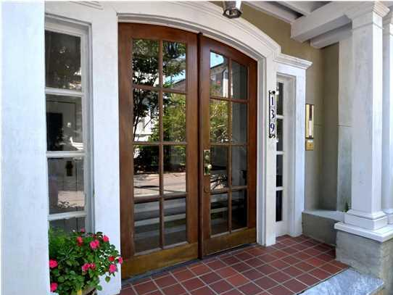
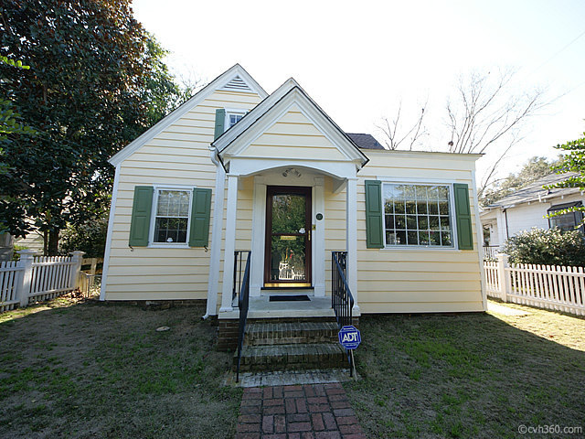
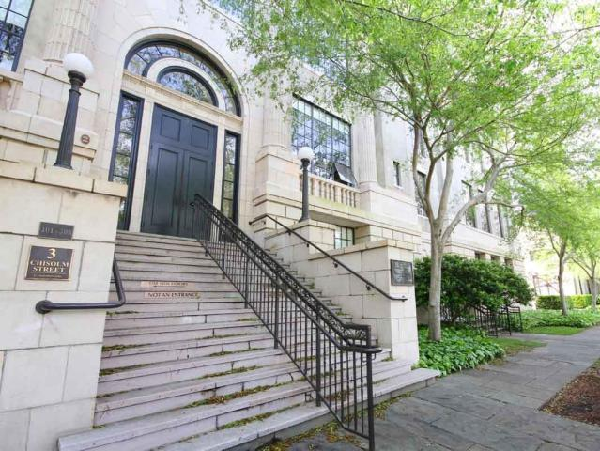


Harleston Village Open Houses Wednesday, April 29th from 11:30am-1:30pm
137 Beaufain Street
MLS# 15000837 - $1,150,000
Check out the virtual tour for more pix!
90 Ashley Avenue
MLS# 14027976 - $1,800,000
139 Tradd Street #6
MLS# 1423448 - $614,000
Check out the virtual tour for more pix!
137 Beaufain Street
MLS# 15000837 - $995,000
3 Chisolm Street #205
MLS# 15009930 - $725,000
Team Bradley O’Mara
843-501-999
RE/MAX ELITE
Joyce King
843-345-8522
DISHER, HAMRICK, & MYERS

