Slide 1
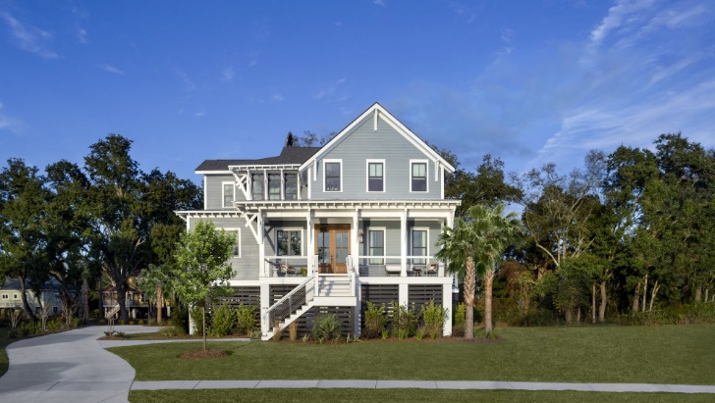
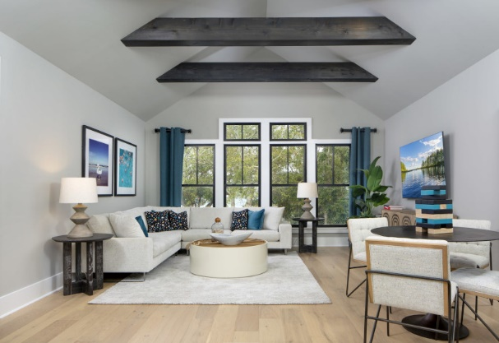
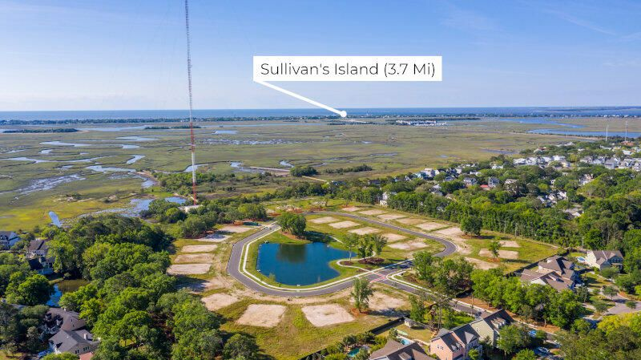

6 Award Winning Custom Plans to Choose From:
Starting at
$1.6M
Only 6 lots
remaining
Visit Our Award-Winning Model At 1529 Tomato Farm Circle
Featuring:
Community dock
GE Monogram Appliances
Impact glass windows
Gorgeous moulding throughout
Elevated Construction with 10- foot ceilings downstairs/ 9- foot upstairs
Fine Craftsmanship
Quartz or Granite countertops
Kohler and Moen Products
Sophisticated and well thought out designs built around your lifestyle
Your dream home awaits…
Angel French
843-367-5333
AFrench@ARHomes.com
www.heirloomlanding.com
COASTAL PREMIER HOMES, LLC

