Slide 1
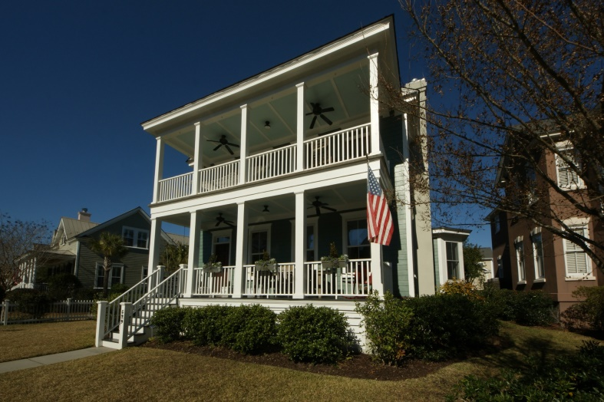
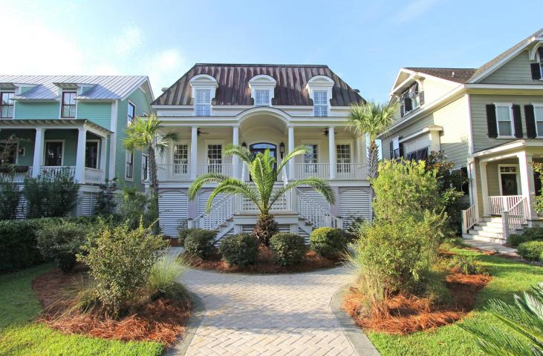
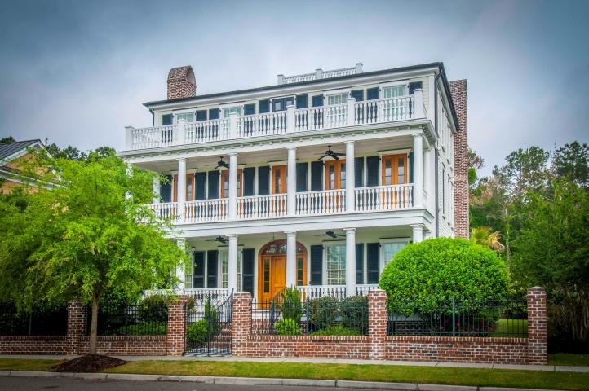
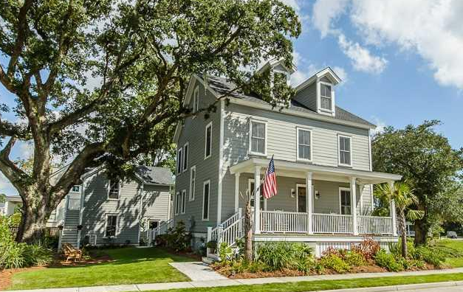
Hibben at Belle Hall Agent Open House - Wednesday March 25, 10-12 Visit all 4 homes to enter a drawing for a gift certificate to Obstinate Daughter
529 Country Place Road
MLS# 15000585 $647,500
738 Hibbens Grant Blvd MLS# 1424844
$698,500
Chuck & Edy Mimms
Sand Dollar Real Estate Group 843-224-9507
mimms@sanddollarsc.com
Sam E Haynes
William Means Real Estate
843-214-4790
sam@williammeans.com
728 Stucco Lane
MLS# 15003703
$1,198,500
345 Bridgetown Pass
MLS# 1426292
$724,900
B.V. Messervy
Carolina One Real Estate
843-452-3630
bvmesservy@carolinaone.com
Bambi Magraw
Keller Williams Realty
843-224-3628
bambi@charlestondwellings.com

