Slide 1
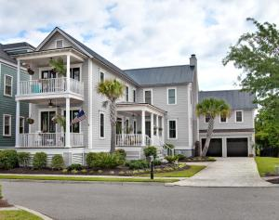
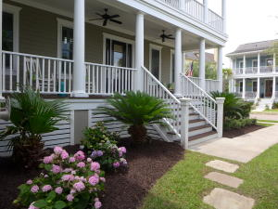
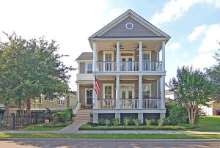
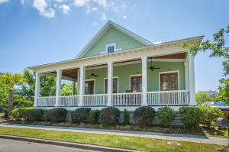
Hibben at Belle Hall
Progressive Luncheon for Agents – Cash drawings!
Thursday, July 14 - 11:30am to 1:30pm
312 Bermuda Towne Row
MLS# 16008888
$749,000
416 Barbadian Way
MLS# 16015044
$759,900
Kathy Jordan
Kathy Jordan Properties
843-442-0782
kathycharleston@gmail.com
Michelle Whitbeck
Keller Williams Realty Charleston
843-270-6057
mwhitbeck@kwchs.com
517 Country Place Road
MLS# 16012924
$670,000
713 Stucco Lane
MLS# 16013973
$824,000
Shane Spurling
Matt O'Neill Real Estate
843-640-9448
shane@mattoneillteam.com
Vanessa Nichols
Carolina One Real Estate
843-209-8007
dedewarren@carolinaone.com

