Slide 1
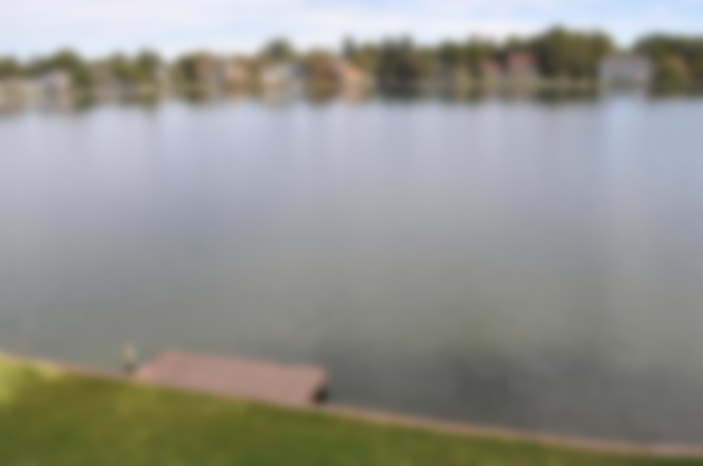
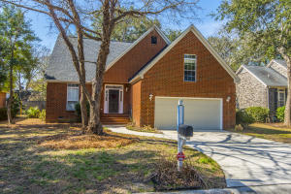
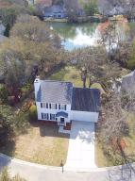
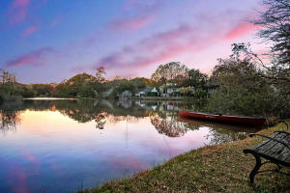
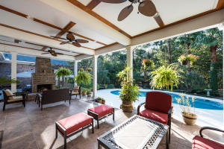
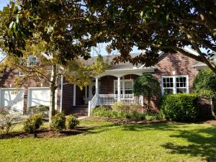
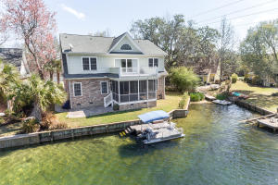
Lakeshore + Center Lake + Hidden Lakes
Agent Open Houses Wednesday April 18 11am-1pm
Lakeshore
Center Lake
1295 Deep Water Dr
MLS # 17030438
$485,000
Mary Molony
Carolina One Real Estate
843-478-8460
1358 Center Lake Dr
MLS # 18007970
$475,000
Mark Macpherson
Give Local Realty
843-367-5640
1382 Center Lake Dr
MLS # 18005689
$485,000
Lisa Quick
Matt O'Neill Real Estate
843-452-6688
Hidden Lakes
The Boulevard Company, LLC
1233 Hidden Lakes Dr
MLS # 17028709
$800,000
Alan Donald
Keller Williams Realty
843-416-1434
1217 Waterfront Dr
4/2.5, 2688sf, Hardwoods $705,000
Margaux Kilgallen
Beresford Realty
843-670-4035
1117 Waterfront Dr
MLS # 18007256
$699,000
Rebecca Linenger
The Boulevard Company
843-364-5818

