Slide 1
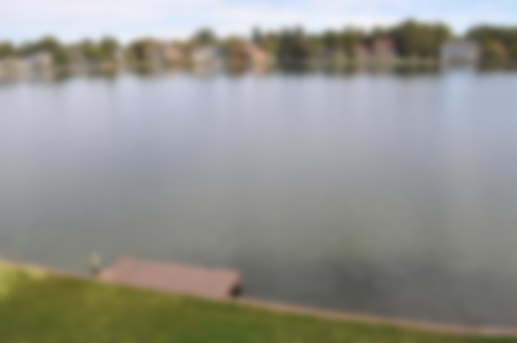
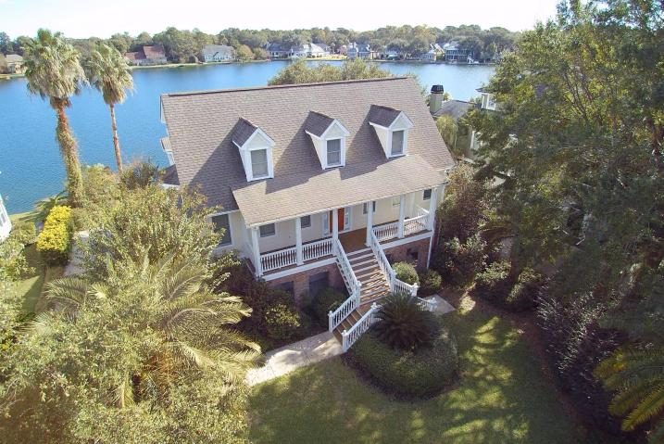
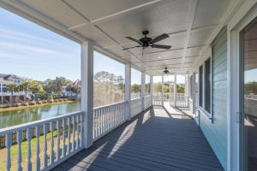
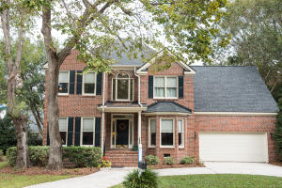
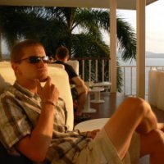
Hidden Lakes/Seaside Farms Broker Open Houses
Thursday, March 30 11am-1pm
1178 Waterfront Drive
Hidden Lakes
MLS# 16028875
$869,000
Mark Macpherson
843-367-5640
mark@beachbreak-properties.com
The Boulevard Company, LLC
2687 Magnolia Woods Drive
Seaside Farms
MLS# 17001077
$929,000
Mikki Ramey
843-729-0302
mikramey@gmail.com
Healthy Realty LLC
1397 Hidden Lakes Drive
Hidden Lakes
MLS# 16028428
$509,900
Tommy Lovett
843-442-1276
tlovett@carolinaone.com
Carolina One Real Estate
The Boulevard Company, LLC

