Slide 1
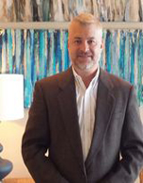

Would you like to learn more about the
Highgarden Real Estate lead generating system?
Free Lead Generation and Fast free training. If you are interested in furthering your real estate career and would like to be considered for a position with Highgarden Real Estate, please contact Rick Knight Confidentiality assured.
Check out our Career Guide
Rick Knight
REALTOR / Division President
e | rknight@highgarden.com
p | 843-655-3517
w | www.rickknight.com
1136 44th Ave N | Suite 2
Myrtle Beach SC 29577
https://user-rgqomxd.cld.bz/Career-Guide-Highgarden-Myrtle-Beach

