Slide 1
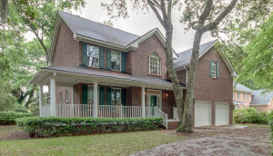
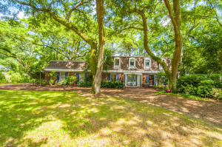
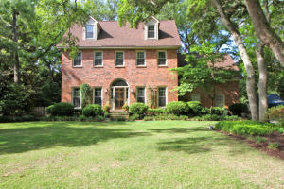
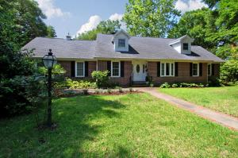
Four Home Agent Preview in Hobcaw Point
Thursday, August 20th, 11am to 1 pm
Come out and enjoy a light lunch & enter a drawing for $100 gift card
312 Bampfield Dr
MLS# 15010003
$845,000
4 Bed - 3½ Bath
Listed by Lori Claussen
Golden Bear Realty
loric@goldenbearrealty.com
843-224-8506
206 Molasses Ln
MLS# 15014948
$830,000
4 Bed - 3½ Bath
Listed by Matt Scarafile
Carolina One Real Estate
mscarafile@carolinaone.com
843-452-4050
307 Molasses Ln
MLS# 15011974
$955,000
4 Bed – 4 Bath
Listed by Robertson Allen
The Cassina Group
rallen@thecassinagroup.com 843-628-0008
133 Sampa Rd
MLS# 15013858
$1,049,000
4 Bed - 3 Bath
Listed by Jimmy Dye The Cassina Group
jdye@thecassinagroup.com
843-628-0008
133 Sampa Rd is no longer part of today’s tour.
Sorry for the late notice.
Please call Jimmy to arrange a personal tour.

