Slide 1
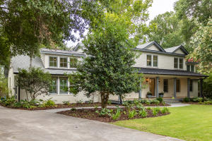
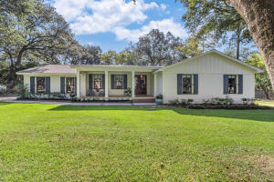
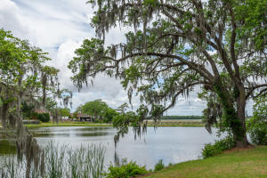
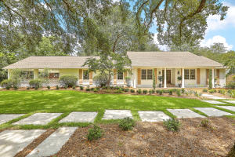
Hobcaw Point Open Houses
Thursday, October 3^{rd,} 2019 from 4-7pm
Come enjoy wine and cheese and leave your business card
at each house for a chance to win a $100 Hall’s gift card
133 Sampa Road
MLS# 19020440
$1,599,900
Jennifer Hale
843-830-6436
jenn.hale@cbcarolinas.com
Coldwell Banker Residential Brokerage
301 Coinbow Drive
MLS# 19026352
$879,900
Catherine Parker
843-800-3046
catherine@cpreco.com
Keller Williams Realty Charleston
344 Coinbow Drive
MLS# 18014055
$1,595,000
Jane Smith
843-266-8000
janes@carriageprop.com
Carriage Properties
402 Hobcaw Drive
MLS# 19022235
$928,000
Tradd Bastian
843-224-0771
tradd@traddbastian.com
Keller Williams Realty Charleston

