Slide 1
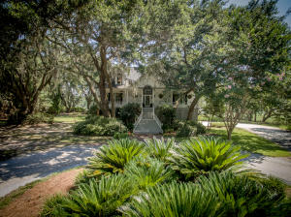
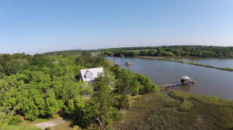
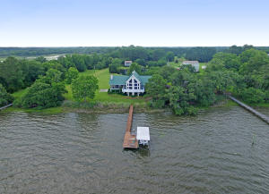
Hollywood/Meggett Agents’ Tour of Waterfront Homes
Wednesday, July 27, 11:00am to 2:00pm
A progressive light lunch will be served.
Agents visiting all three homes on the tour will be entered into a drawing for a $100.00 gift card.
7432 Little Britton Road
Ashe Point
Hollywood, SC 29449
MLS# 16016968
$999,000
Carla Garbarini
Century 21 Properties Plus
843-814-6332
cmschultz@nstech.us
4367 Park Island Road
Park Island
Meggett, SC 29449
MLS# 15012125
$846,000
Owen Tyler
The Cassina Group
843-224-5398
owen@thecassinagroup.com
5961 Shealy Drive
Meggett
Meggett, SC 29449
MLS# 16016594
$979,000
Lauren Zurilla
Matt O'Neill Real Estate
410-322-0220
lauren@mattoneillteam.com

