Slide 1
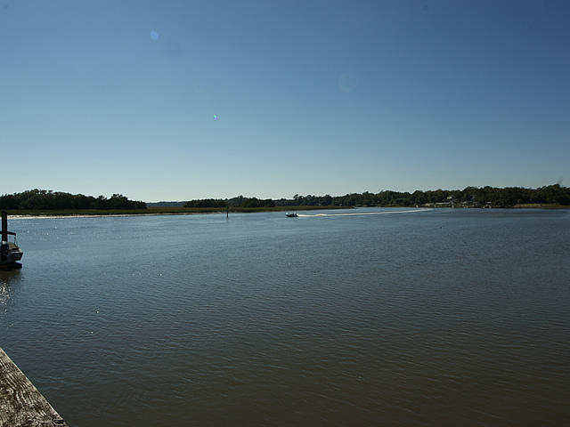
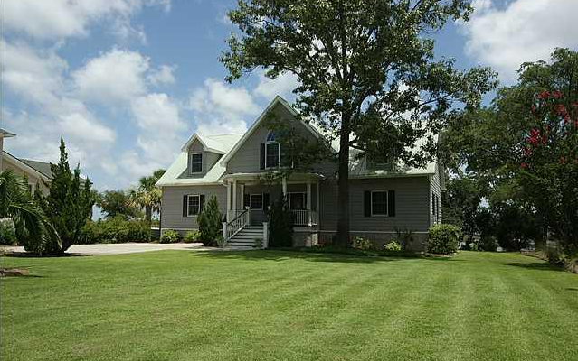
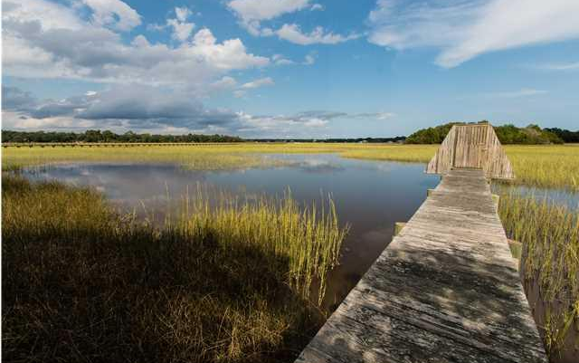
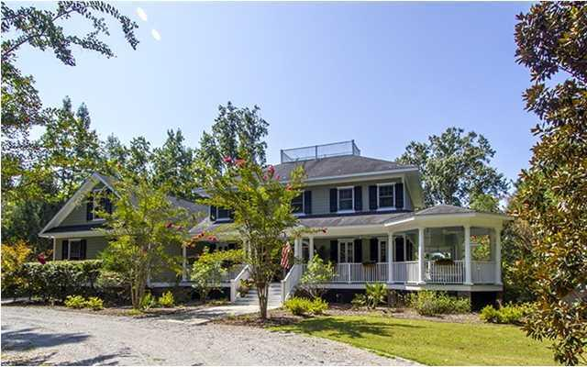
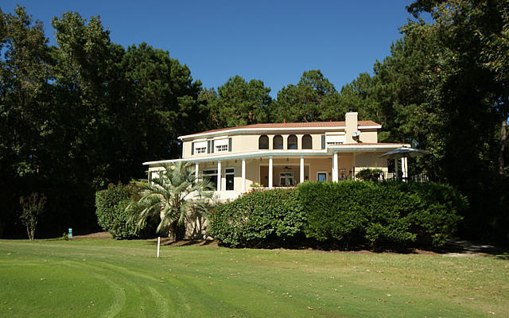
Hollywood Agent Open House
Thursday, February 26th from 12-3
Come Tour Four Luxury Homes in Hollywood
Lunch served at 5694 Captain Kidd Rd in Royal Harbor &
refreshments are served at 5153 Old York Course in Stono Ferry.
Drawings for $100, $50 and $25 gift cards and other prizes!!
You must visit each of the four homes to qualify for the drawings.
5694 Captain Kidd Road
Royal Harbor
MLS# 1418791
$940,000
Listed by Jeanette Turner
Keller Williams Realty
843-814-1355
jeanetteturner100@gmail.com
4957 Stirrup Cup Lane
Stono Ferry
MLS# 1425117
$950,000
Listed by Bill Bladykas
BHHS Carolina Sun
843-906-2036
billbladykas@gmail.com
5103 Timber Race Course
Stono Ferry
MLS# 1422897
$675,000
Listed by Betsy Gordon
Handsome Properties
843-475-2329
betsy@handsomeproperties.com
5153 Old York Course
Stono Ferry
MLS# 14027463
$1,695,000
Listed by Jeff Lackey
Keller Williams Realty
843-364-5149
lackeyb54@yahoo.com

