Slide 1
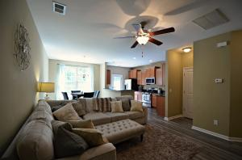
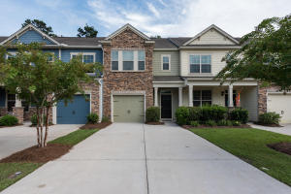
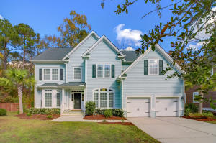
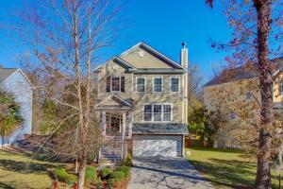
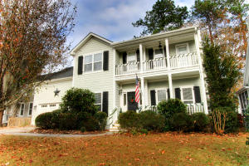
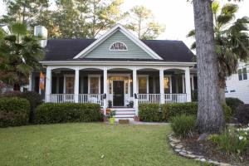
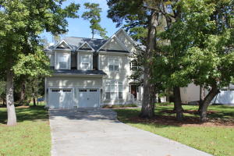
Hunt Club Agent Open House Tour
Saturday, January 13th, from 1-4
817 Bibury Court
MLS# 17025407
$220,000
Andrew Sorrentino | Kelly Rozier
AgentOwned Charleston Group
843-371-6218 | 843-209-3129
823 Bibury Court
MLS# 17022915
$228,000
Caitlyn Elizabeth Cleary
BHHS Carolina Sun Real Estate
860-798-1589
1144 Idbury Lane
MLS# 17031840
$398,500
Tammy Trenholm
Redfin Corporation
843-514-1454
1497 Gator Trak
MLS# 17032676
$370,000
Suzy Kopp
Keller Williams Realty Chas. Islands
843-224-1212
1130 Quick Rabbit Loop
MLS# 17033040
$345,000
Audra Walters
ChuckTown Homes, LLC
843-608-8149
1134 Quick Rabbit Loop
MLS# 17029963
$339,000
Audra Walters
ChuckTown Homes, LLC
843-608-8149
1220 Walleye Corner
MLS# 17029433
$2,700
Jessica Reid
Montford Real Estate
843-532-3604

